Slide 1
Unit 4 topics
Medium Access Control Techniques
Random, Round Robin, Reservation, ALOHA
Pure and Slotted, CSMA/CD
CSMA/CA, Ethernet, Token Ring, Token Bus,
ARQ 3 Types,
Error Detection Codes, Parity Check, Checksum
Error Correction Codes,Hamming codes

Slide 2
UNIT IV DATA LINK LAYER
Medium Access Control Techniques
A mechanism which provides a link with reliable communication.
There is an available dedicated link(or channel) between the sender and the receiver.
Example: if we use our cellular phone to connect to another cellular phone, the channel( the band allocated to the vendor company) is not dedicated.
It has two sublayers.
Upper sublayer is responsible for data link control.
Lower sublayer is responsible for resolving access to the shared media.

Slide 3
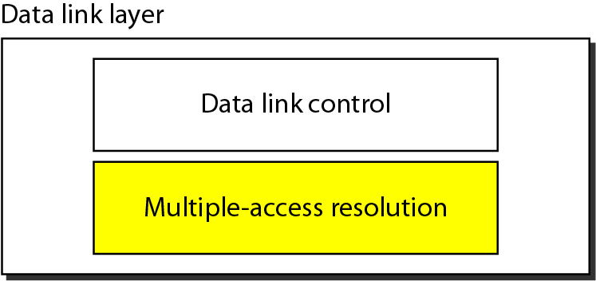
Data link layer divided into two functionality-oriented sublayers
The upper sublayer is responsible for flow and error control is called Logical Link Control(LLC) layer.
The lower sublayer is responsible for multiple access resolution is called the media access control (MAC) layer.
When nodes or stations are connected and use a common link called a multipoint or broadcast link, we need a multiple access protocol to coordinate access to the link.
Eg: assembly.

Slide 4
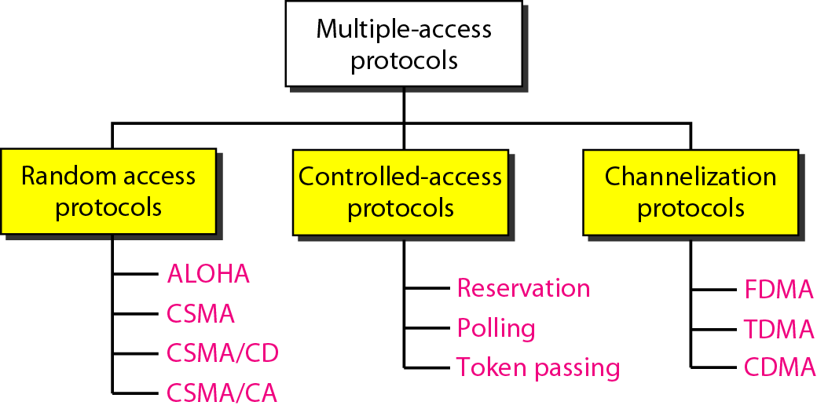
Taxonomy of multiple-access protocols

Slide 5
CONTROLLED ACCESS
In controlled access, the stations consult one another to find which station has the right to send.
A station cannot send unless it has been authorized by other stations.
Three popular controlled-access methods.
Reservation
Polling
Token Passing

Slide 6
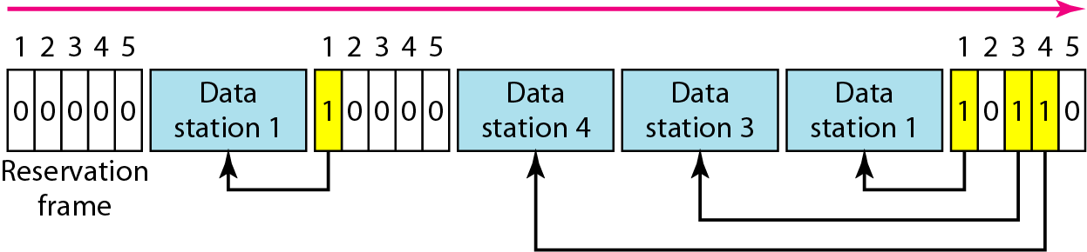
Reservation
In the reservation method, a station needs to make a reservation before sending data.
Time is divided into intervals. In each interval, a reservation frame precedes the data frames in that interval.
If there are N stations in the system, there are exactly N reservation minislots in the reservation frame. Each minislot belongs to a station.

Slide 7
Polling
It works with topologies in which one device is designated as a primary station and the other devices are secondary stations.
The primary device controls the link.
The secondary devices follow its instructions.
Primary device is to determine which device is allowed to use the channel at a given time.(initiator of a session).
If the primary wants to receive data, it asks the secondaries if they have anything to send, this is called poll function.(poll)
If the primary wants to send data, it tells the secondary to get ready to receive, this is called select function.(SEL)

Slide 8
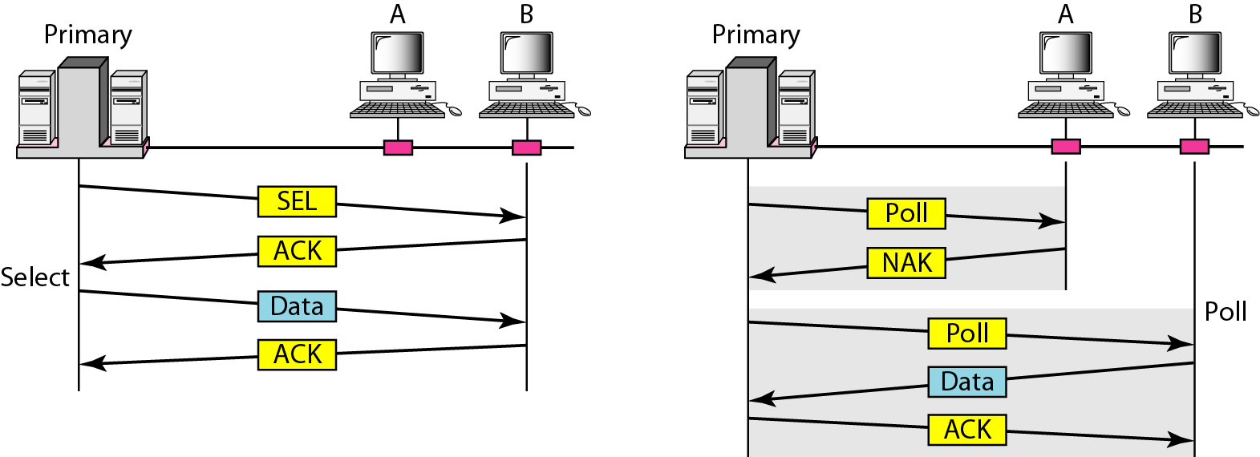
Select and poll functions in polling access method

Slide 9
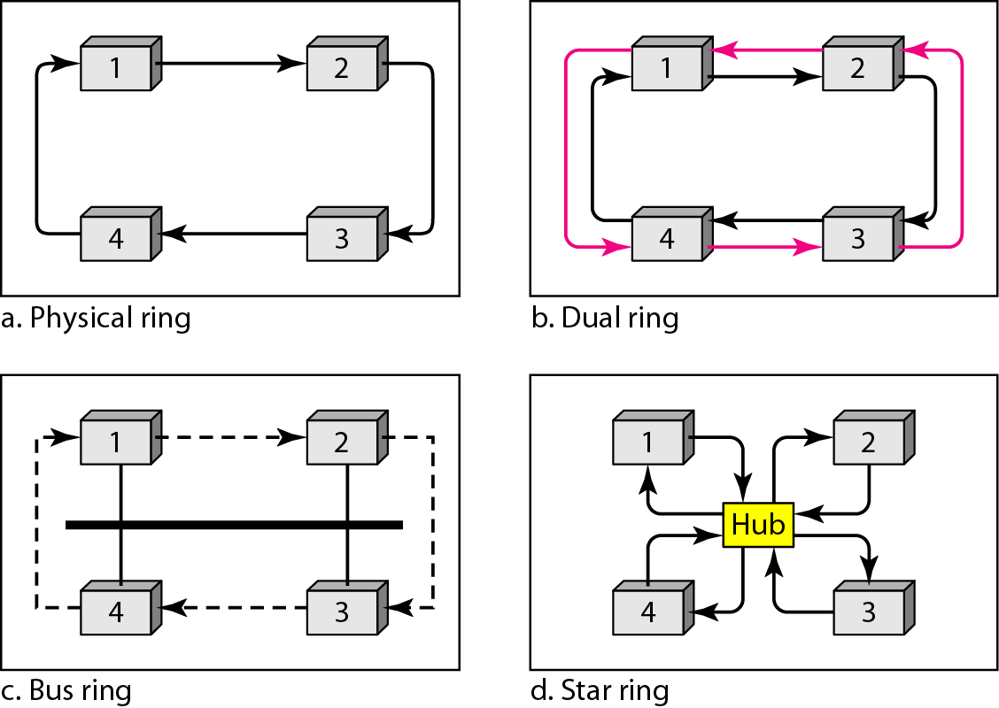
Token Passing
The stations in a network are organized in a logical ring.
For each station, there is a predecessor and a successor.
A special packet called a token circulates through the ring.
Token management, the token must be monitored to ensure it has not been lost or destroyed.
Logical ring and physical topology in token-passing access method

Slide 10
RANDOM ACCESS
In random access or contention methods, no station is superior to another station and none is assigned the control over another.
No station permits, or does not permit, another station to send.
At each instance, a station that has data to send uses a procedure defined by the protocol to make a decision on whether or not to send.
Two features
There is no schedule time for a station to transmit. Transmission is random among the stations.
No rules specify which station should send next. Stations compete with one another to access the medium
If more than one station tries to send, there is an access conflict-Collision and the frames will be either destroyed or modified.

Slide 11
ALOHA, protocol which is used a very simple procedure called multiple access.
The method was improved with the procedure that forces the station to sense the medium before transmitting. This was called Carrier Sense Multiple Access
Carrier Sense Multiple Access with Collision Detection(CSMA/CD)
Carrier Sense Multiple Access with Collision Avoidance (CSMA/CA)
ALOHA
It was designed for a radio(wireless) LAN, but it can be used on any shared medium.
Types of ALOHA
Pure ALOHA
Slotted ALOHA
Pure ALOHA(original ALOHA)
Each station sends a frame whenever it has a frame to send.
We need to mention that even if one bit of a frame coexists on the channel with one bit from another frame, there is a collision and both will be destroyed.

Slide 12
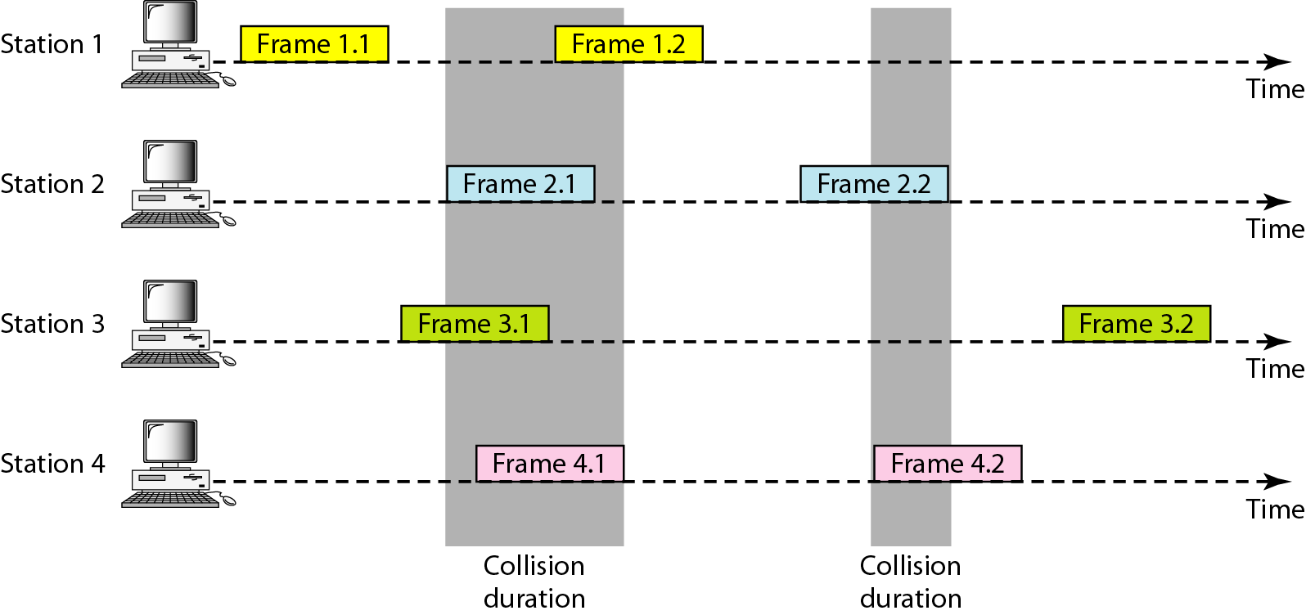
Frames in a pure ALOHA network
Need to resend the frames that have been destroyed during transmission.
Acknowledgement(time-out period)
_{Methods to prevent collision:}
Back-off time TB.(random amount of time)
After a maximum number of retransmission attempts Kmax, a station must give up and try later.

Slide 13
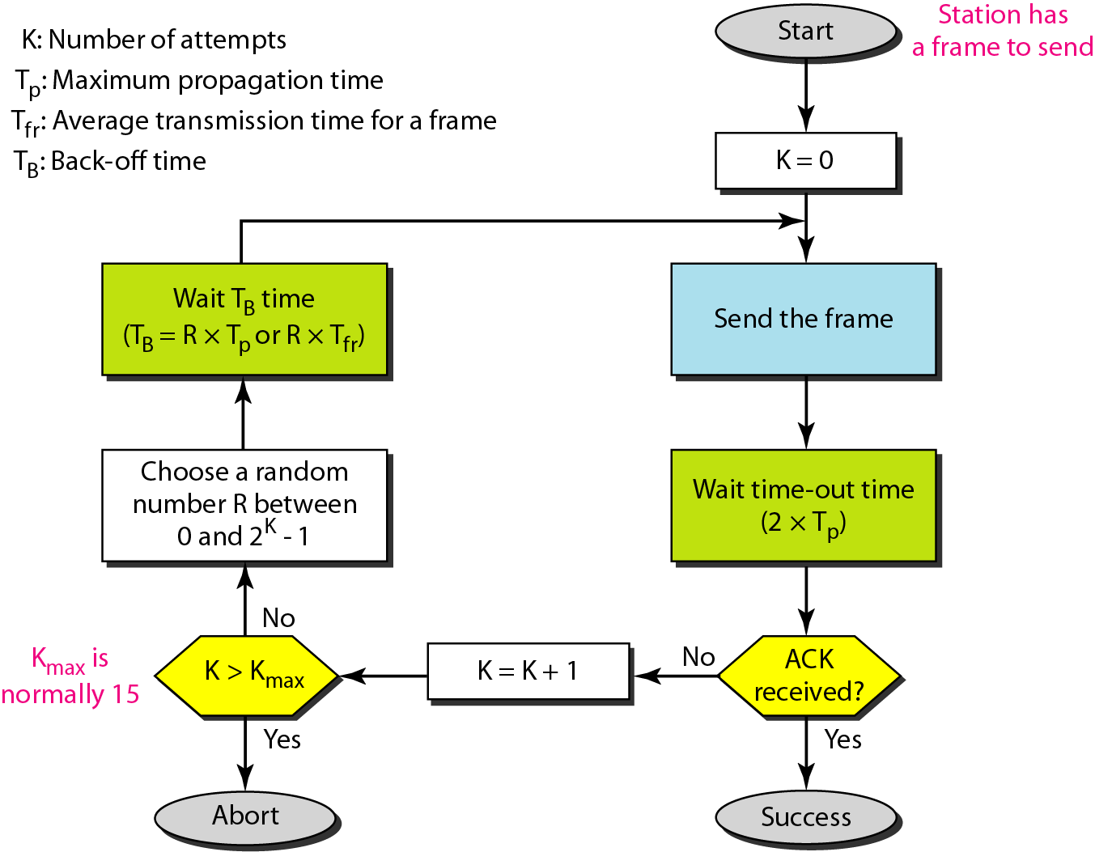
Procedure for pure ALOHA protocol
Time out = maximum possible round-trip propagation delay, which is twice the amount of time required to send a frame between separated stations(2*TP)

Slide 14
Example: The stations on a wireless ALOHA network are a maximum of 600 km apart. If we assume that signals propagate at 3 × 10⁸ m/s, we find Tp = (600 × 10⁵ ) / (3 × 10⁸ ) = 2 ms. Now we can find the value of T_{B} for different values of K .
a. For K = 1, the range is {0, 1}. The station needs to generate a random number with a value of 0 or 1. This means that T_{B} is either 0 ms (0 × 2) or 2 ms (1 × 2),based on the outcome of the random variable.
b. For K = 2, the range is {0, 1, 2, 3}. This means that T_{B} can be 0, 2, 4, or 6 ms, based on the outcome of the random variable.
c. For K = 3, the range is {0, 1, 2, 3, 4, 5, 6, 7}. This means that T_{B} can be 0, 2, 4, . . . , 14 ms, based on the outcome of the random variable.
d. We need to mention that if K > 10, it is normally set to 10.

Slide 15
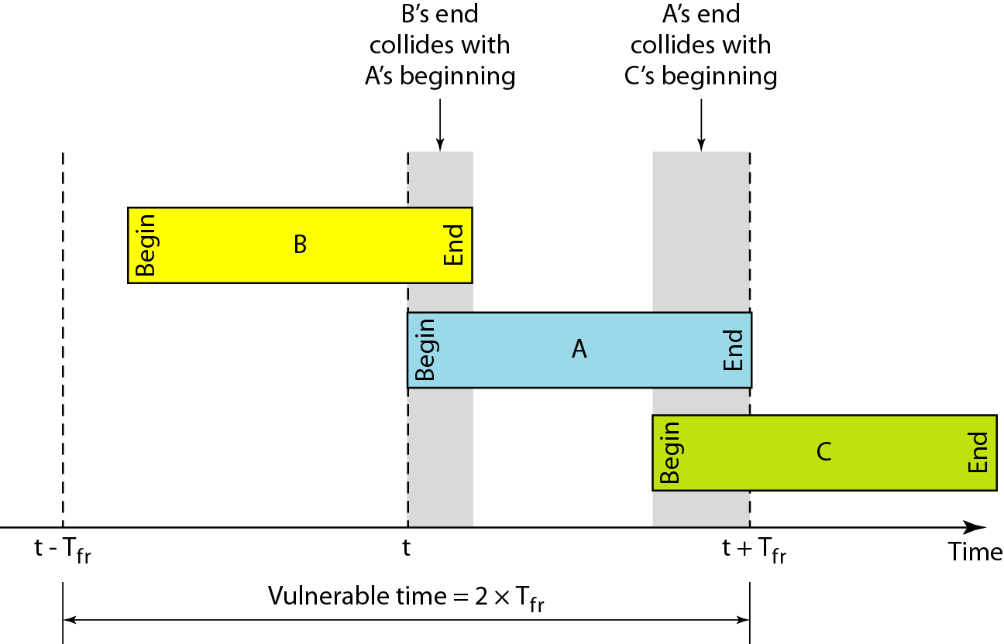
Vulnerable time for pure ALOHA protocol

Slide 16
Example for vulnerable time
A pure ALOHA network transmits 200-bit frames on a shared channel of 200 kbps. What is the requirement to make this frame collision-free?
Solution
Average frame transmission time T_{fr} is 200 bits/200 kbps or 1 ms. The vulnerable time is 2 × 1 ms = 2 ms. This means no station should send later than 1 ms before this station starts transmission and no station should start sending during the one 1-ms period that this station is sending.
_{Throughput}
Let G be the average number of frames generated by the system during one frame transmission time.
The average number of successful transmission for pure ALOHA is S = G × e ^{−2G}
^{The maximum throughput} S_{max} = 0.184 when G= (1/2).
If one half a frame is generated during one frame transmission time, then 18.4% of these frames reach their destination successfully.

Slide 17
Example for throughput
A pure ALOHA network transmits 200-bit frames on a shared channel of 200 kbps. What is the throughput if the system (all stations together) produces
a. 1000 frames per second b. 500 frames per second c. 250 frames per second.
Solution
The frame transmission time is 200/200 kbps or 1 ms.
If the system creates 1000 frames per second, the load is 1. in this case S=G × e^{−2 G} or S=0.135(13.5%). This means that the throughput is 1000 X 0.135=135 frames. Only 135 frames out of 1000 will probably survive.
If the system creates 500 frames per second, the load is 1/2. in this case S=G × e^{−2 G} or S=0.184(18.4%). This means that the throughput is 500 X 0.184=92 frames. Only 92 frames out of 500 will probably survive.
If the system creates 250 frames per second, the load is 1/4. in this case S=G × e^{−2 G} or S=0.152(15.2%). This means that the throughput is 250 X 0.152=38 frames. Only 38 frames out of 250 will probably survive.

Slide 18
Slotted ALOHA
In slotted ALOHA, we divide the time into slots of T_{fr} and force the station to send only at the beginning of the time slot.
If a station misses the moment, it must wait until the beginning of the next time slot.
The station which started at the beginning of this slot has already finished sending its frame.
Collision
If two stations try to send at the beginning of the same time slot.
However the vulnerable time is now reduced to one-half, equal to T_{fr.}
Slotted ALOHA vulnerable time = T_{fr}

Slide 19
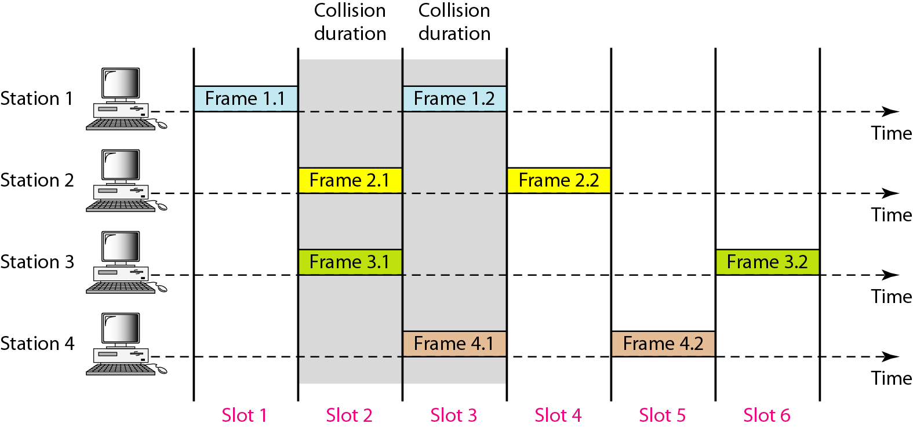
Frames in a slotted ALOHA network

Slide 20
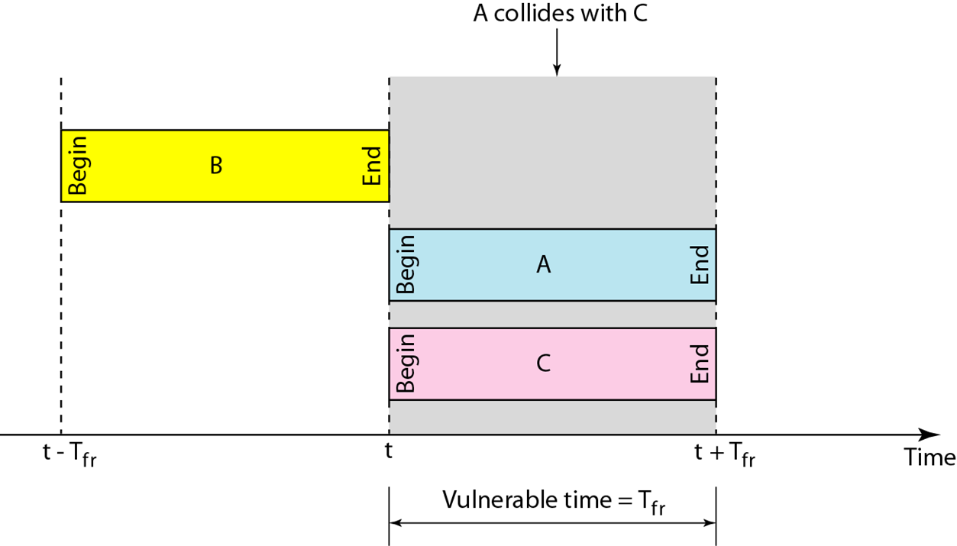
Throughput
The throughput for slotted ALOHA is S = G × e−G .
The maximum throughput Smax = 0.368 when G = 1.
Vulnerable time for slotted ALOHA protocol

Slide 21
Example
A slotted ALOHA network transmits 200-bit frames on a shared channel of 200 kbps. What is the throughput if the system (all stations together) produces
a. 1000 frames per second b. 500 frames per second c. 250 frames per second.
Solution
The frame transmission time is 200/200 kbps or 1 ms.
If the system creates 1000 frames per second, the load is 1. in this case S=G × e^{−G} or S=0.368(36.8%). This means that the throughput is 1000 X 0.368=368 frames. Only 368 frames out of 1000 will probably survive.
If the system creates 500 frames per second, the load is 1/2. in this case S=G × e^{−G} or S=0.303(30.3%). This means that the throughput is 500 X 0.303=151 frames. Only 151 frames out of 500 will probably survive.
If the system creates 250 frames per second, the load is 1/4. in this case S=G × e^{−G} or S=0.195(19.5%). This means that the throughput is 250 X 0.195=49 frames. Only 49 frames out of 250 will probably survive.

Slide 22
Carrier Sense Multiple Access(CSMA)
CSMA requires that each station first listen to the medium before sending.( Sense before transmit)
It can reduce the possibility of collision, but it cannot eliminate it.
The possibility of collision still exists because of propagation delay.
A station may sense the medium and find it idle, only because the first bit sent by another station has not yet been received.
At time t1, station B senses the medium and find it idle, so it sends a frame.
At time t2(t2>t1), station c senses the medium and finds it idle because at this time, the first bits from station B have not reached station C. station C also sends a frame.
The two signals collide and both frames are destroyed.

Slide 23
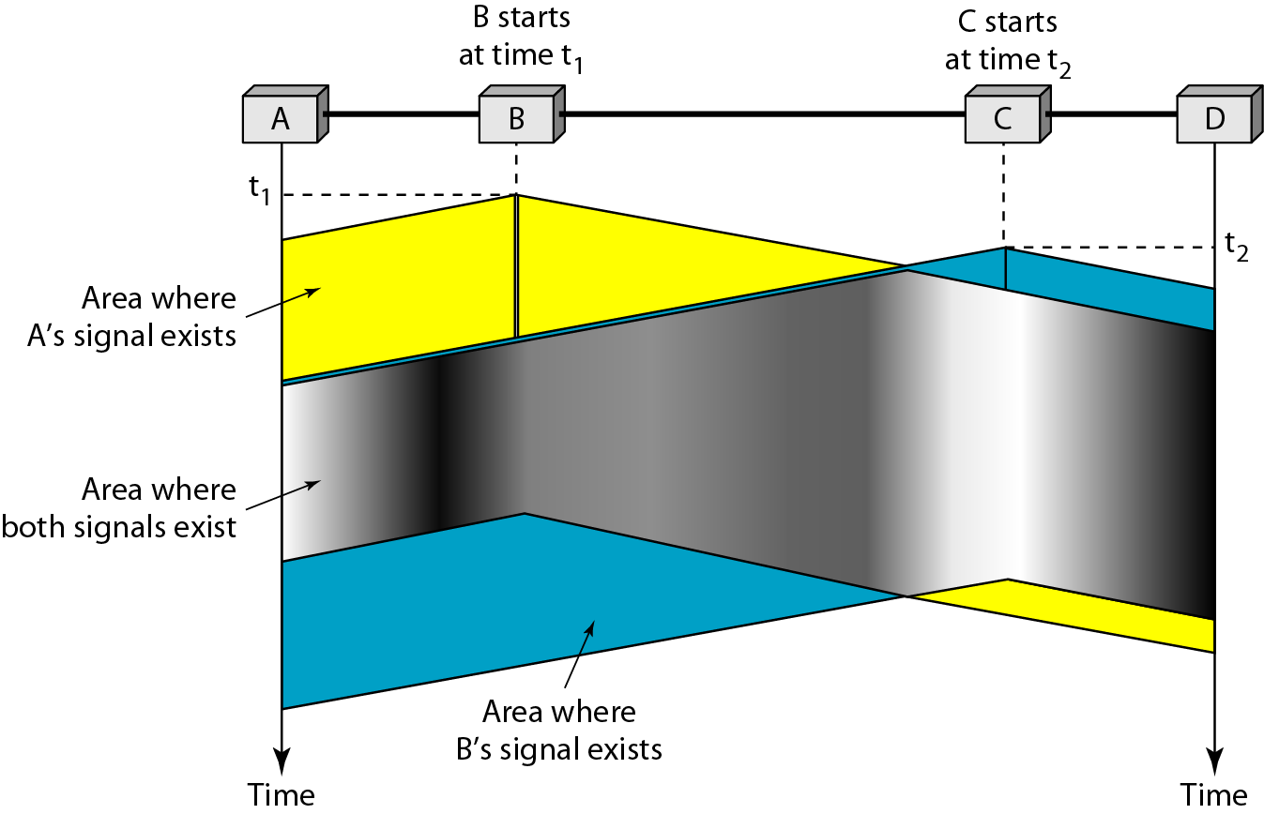
Figure Space/time model of the collision in CSMA

Slide 24
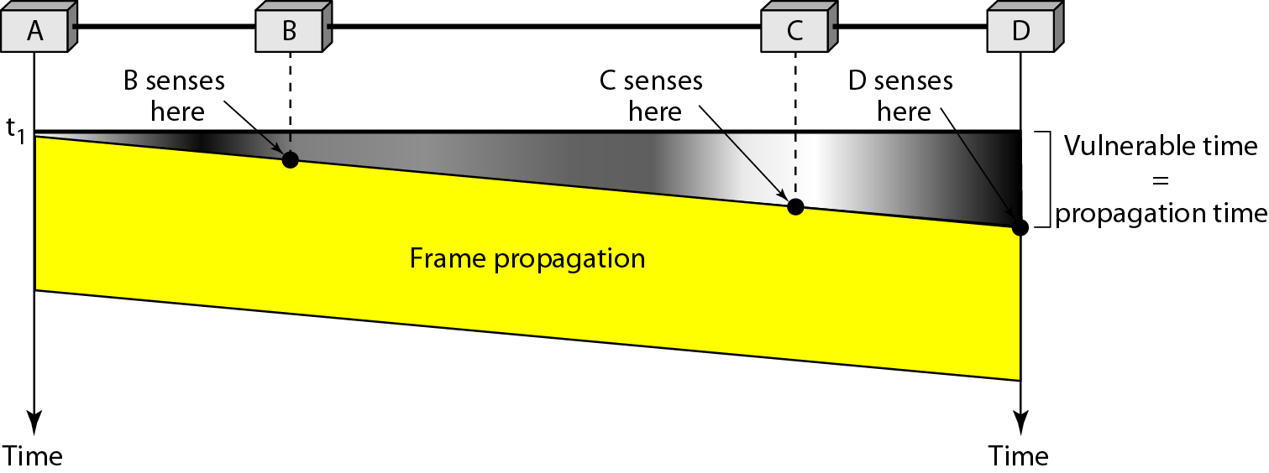
Vulnerable time in CSMA
Propagation time Tp- time needed for a signal to propagate from one end of the medium to the other.
The leftmost station A sends a frame at time t1, which reaches the rightmost station D at time t1+Tp.

Slide 25
Persistence Methods
What should a station do if the channel is busy or is idle?
1-Persistent(Probability 1)
After the station finds the line idle, it sends its frame immediately. This method has the highest chance of collision.
NonPersistent
A station that has a frame to send senses the line. If the line is idle, it sends immediately. If the line is not idle, it waits a random amount of time and then senses the line again.
It reduces the chance of collision and it reduces the efficiency of the network.
p-Persistent
This method is used if the channel has time slots with a slot duration equal to or greater than the maximum propagation time.
It combines the advantages of the other two methods.
It reduces the chance of collision and improves efficiency

Slide 26
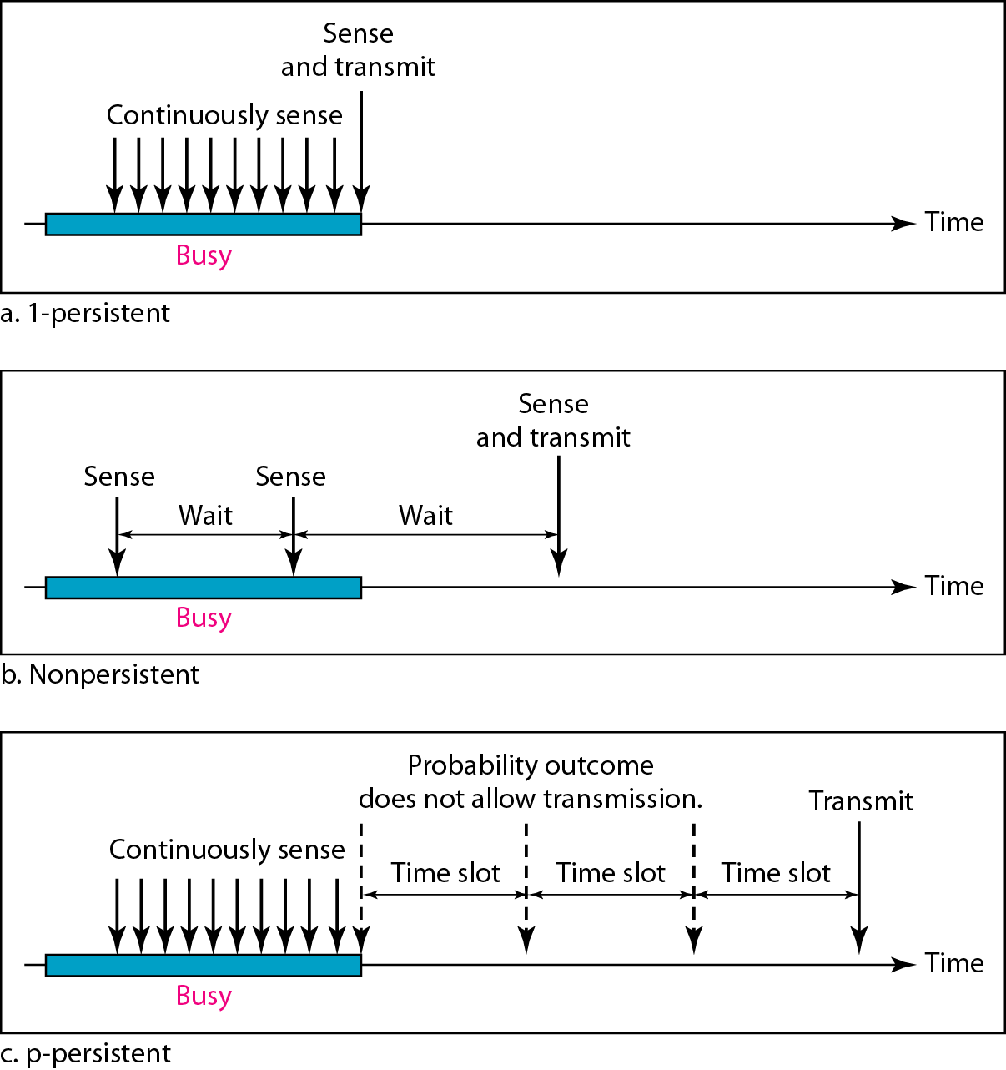
With probability p, the station sends its frame.
With probability q=1-p, the station waits for beginning of the next time slot and checks the line again

Slide 27
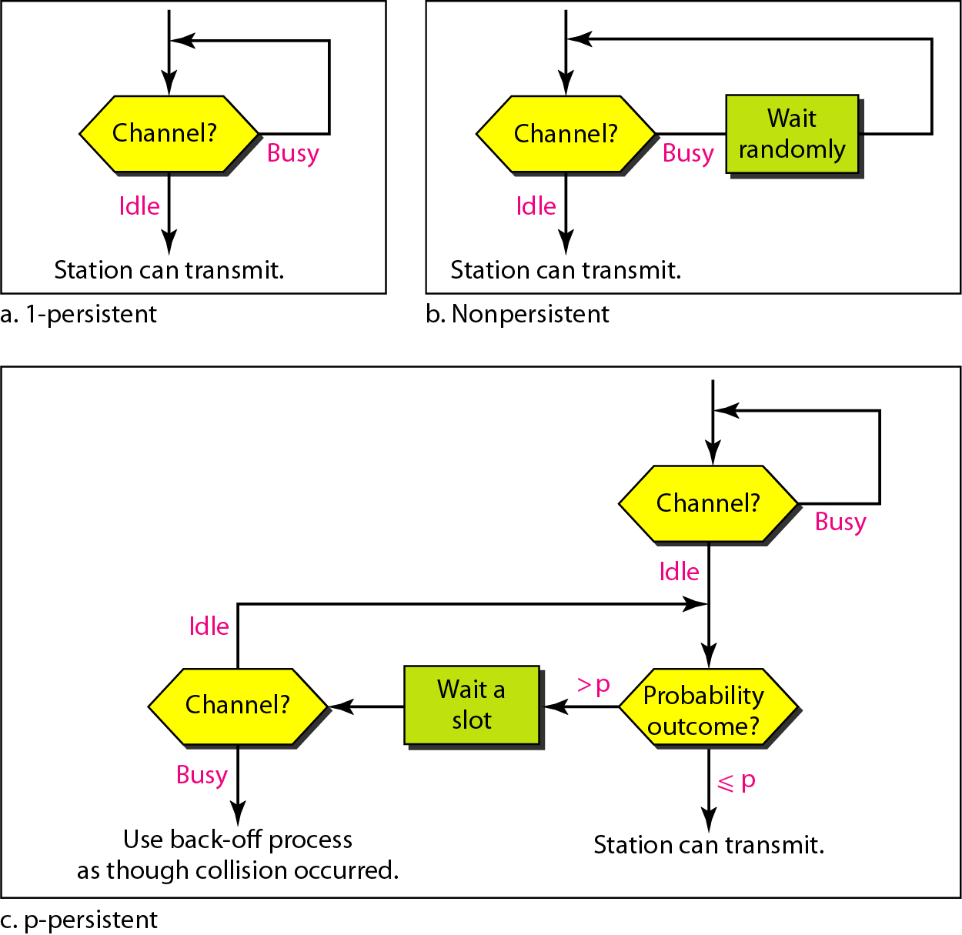
Figure Flow diagram for three persistence methods

Slide 28
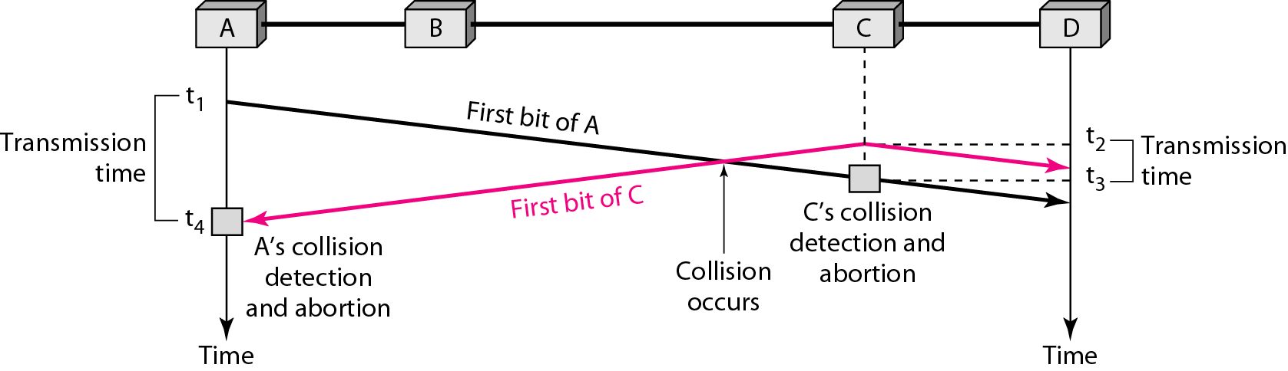
CSMA/CD

Slide 29
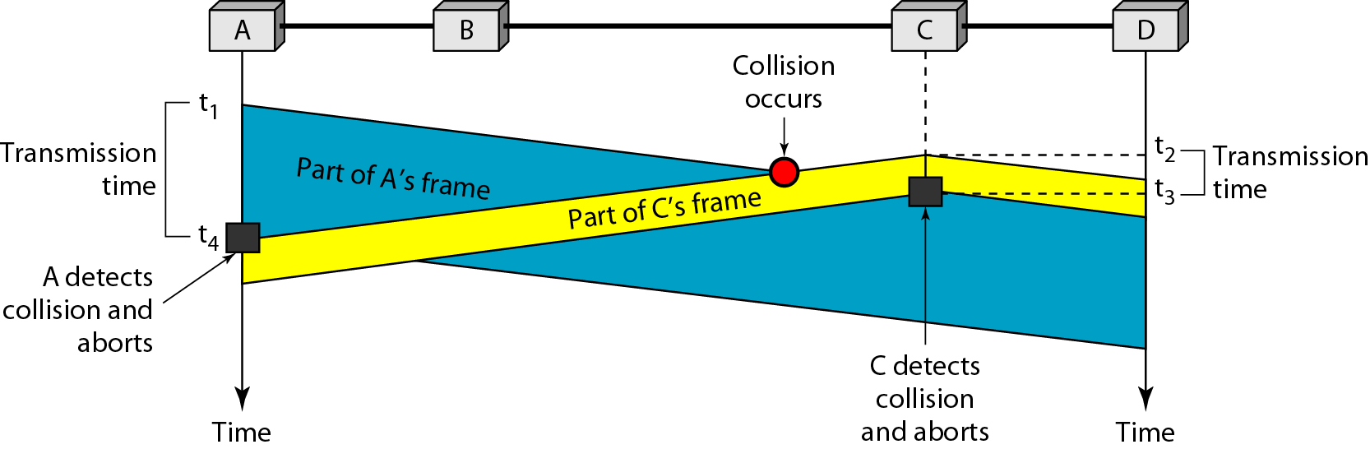
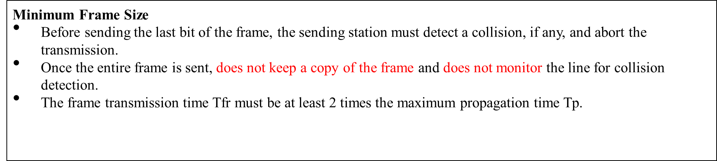
Figure Collision and abortion in CSMA/CD

Slide 30
Example
A network using CSMA/CD has a bandwidth of 10 Mbps. If the maximum propagation time (including the delays in the devices and ignoring the time needed to send a jamming signal, as we see later) is 25.6 μs, what is the minimum size of the frame?
Solution
The frame transmission time is T_{fr} = 2 × T_{p} = 51.2 μs. This means, in the worst case, a station needs to transmit for a period of 51.2 μs to detect the collision. The minimum size of the frame is 10 Mbps × 51.2 μs = 512 bits or 64 bytes. This is actually the minimum size of the frame for Standard Ethernet.
_{Throughput}
The maximum throughput occurs at a different value of G and is based on the persistence method.
For 1-persistent method the maximum throughput is around 50% when G=1.
For nopersistent method, the maximum throughput can go up to 90% when G is between 3 and 8.

Slide 31
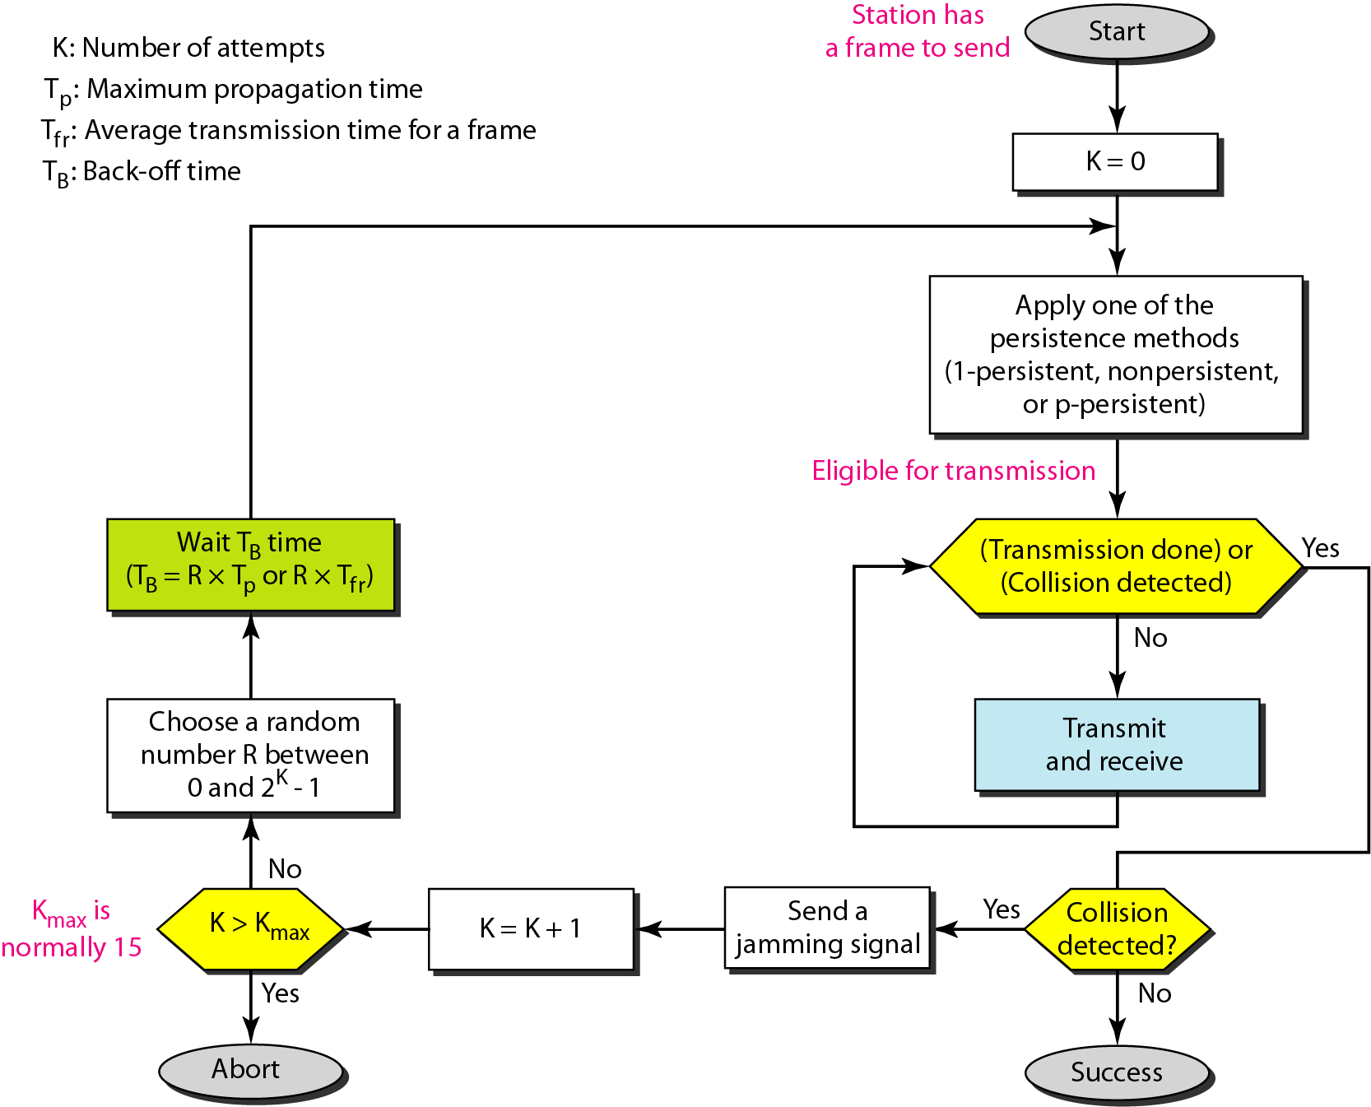
Flow diagram for the CSMA/CD

Slide 32
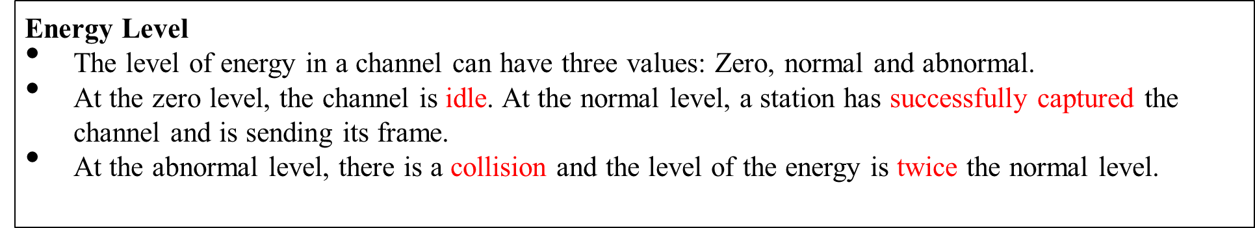
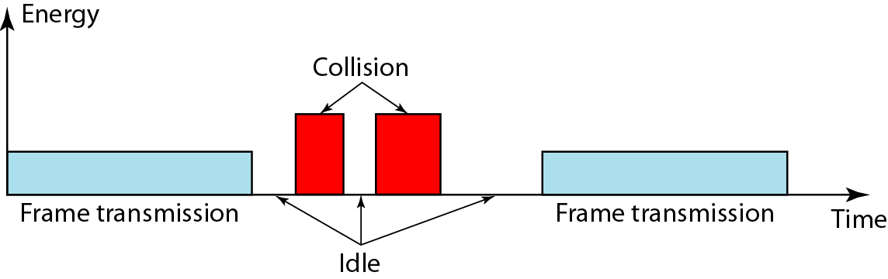
Energy level during transmission, idleness, or collision

Slide 33
CSMA/CA
Interframe space(IFS)
When an idle channel is found, the station does not send immediately. It waits for a period of time(IFS).
In CSMA/CA, the IFS can also be used to define the priority of a station or a frame.
Contention window
The contention window is an amount of time divided into slots. A station that is ready to send chooses a random number of slots as its wait time.
The number of slots in the window changes according to the binary exponential back off strategy.
In CSMA/CA, if the station finds the channel busy, it does not restart the timer of the contention window; it stops the timer and restarts it when the channel becomes idle.

Slide 34
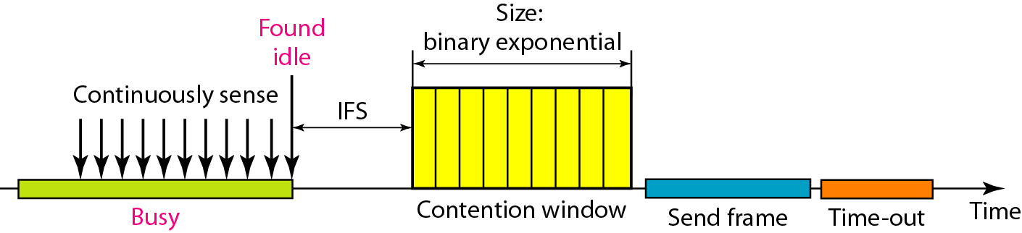
Figure Timing in CSMA/CA
_{Acknowledgement}
With all these precautions, there still may be a collision resulting in destroyed data.
The data may be corrupted during the transmission.
The positive acknowledgement and the time-out timer can help guarantee that the receiver has received the frame.

Slide 35
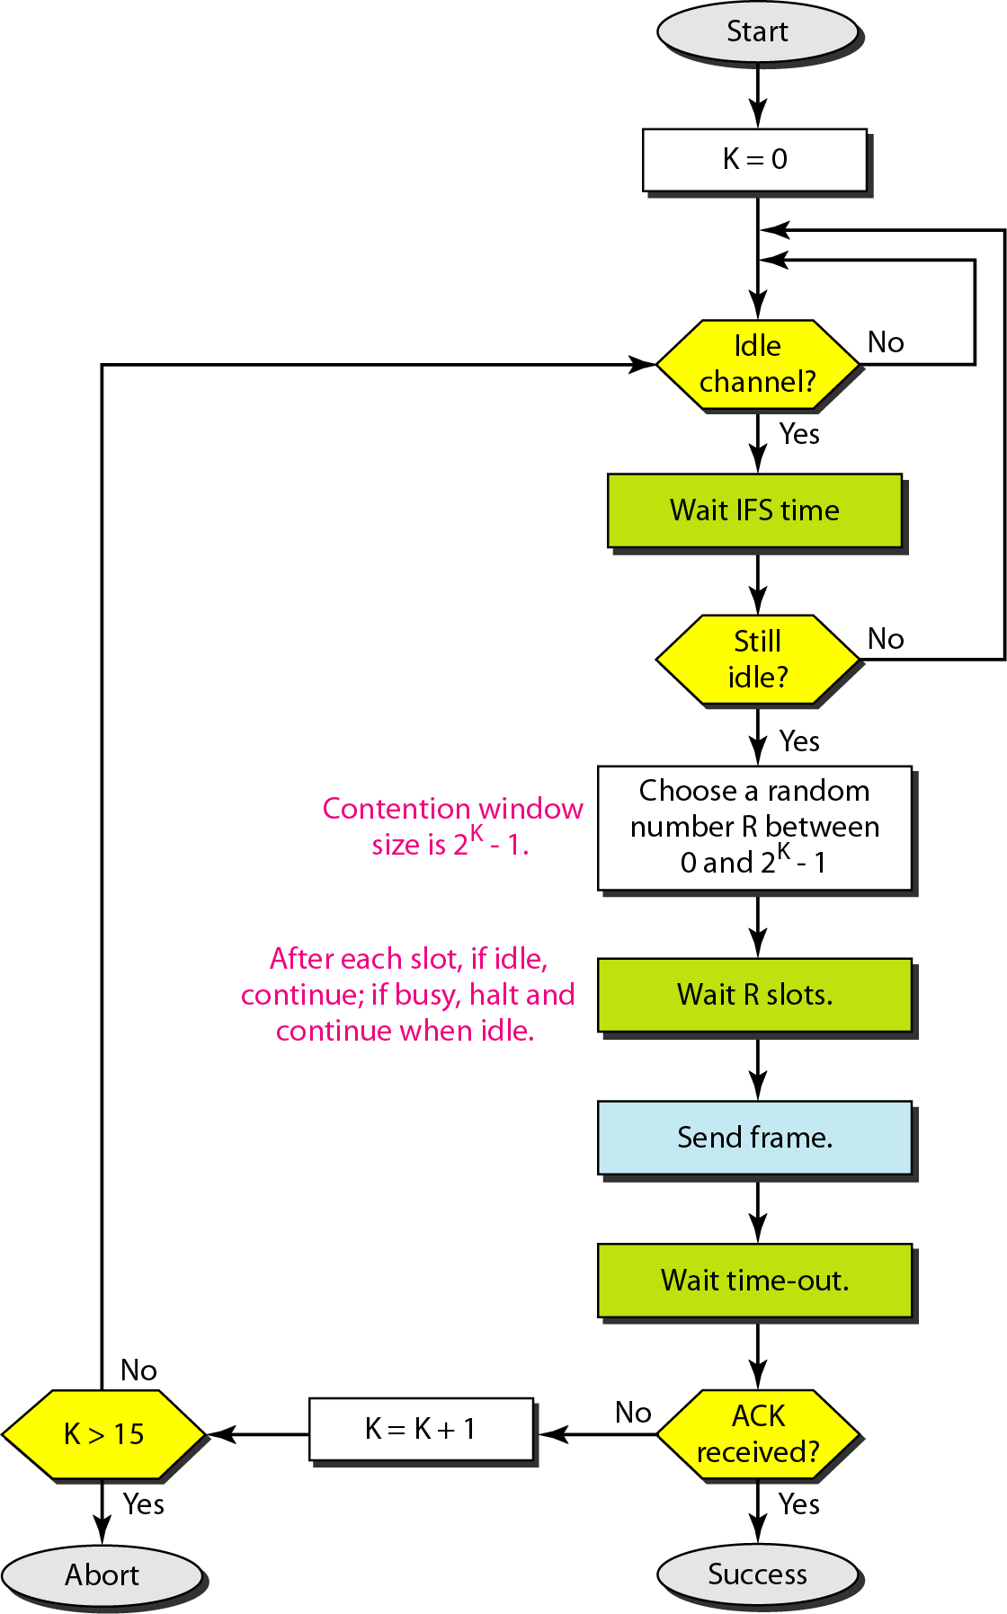
Flow diagram for CSMA/CA

Slide 36
FLOW AND ERROR CONTROL
Flow control refers to a set of procedures used to restrict the amount of data that the sender can send before waiting for acknowledgment.
Error control in the data link layer is based on automatic repeat request, which is the retransmission of data.
ARQ types
Stop-and-Wait Automatic Repeat Request
Go-Back-N Automatic Repeat Request
Selective Repeat Automatic Repeat Request

Slide 37
Stop-and-Wait Automatic Repeat Request
Error correction in Stop-and-Wait ARQ is done by keeping a copy of the sent frame and retransmitting of the frame when the timer expires.
In Stop-and-Wait ARQ, we use sequence numbers to number the frames. The sequence numbers are based on modulo-2 arithmetic.
In Stop-and-Wait ARQ, the acknowledgment number always announces in modulo-2 arithmetic the sequence number of the next frame expected.

Slide 38
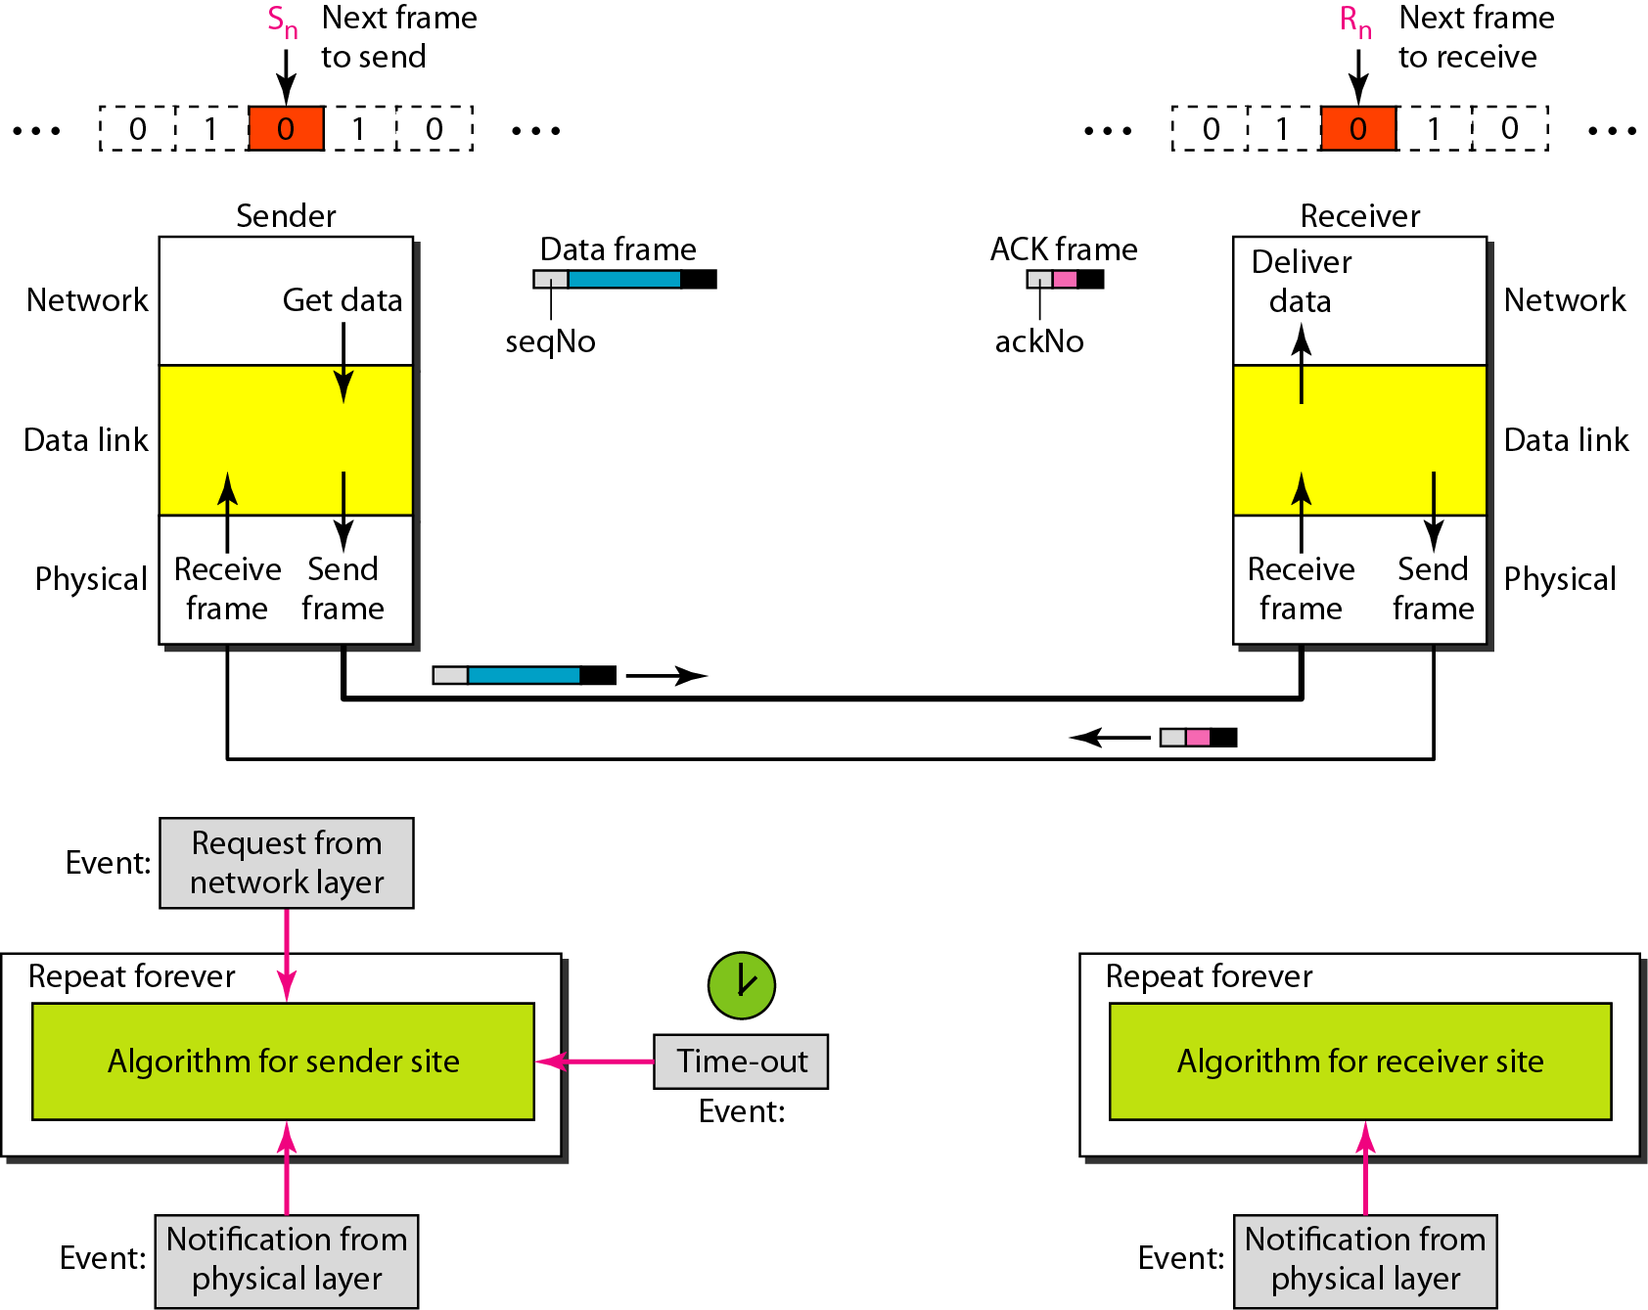
Design of the Stop-and-Wait ARQ Protocol

Slide 39
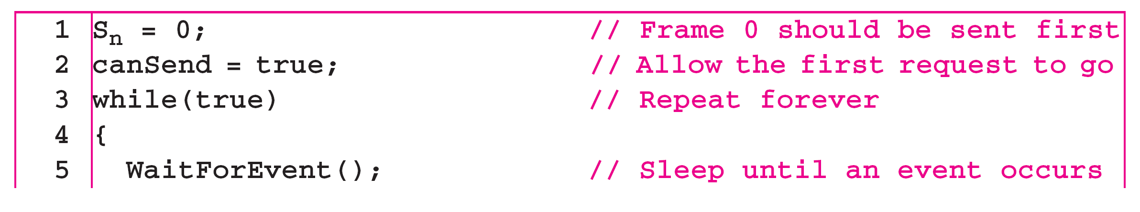
Sender-site algorithm for Stop-and-Wait ARQ

Slide 40
Sender-site algorithm for Stop-and-Wait ARQ

Slide 41
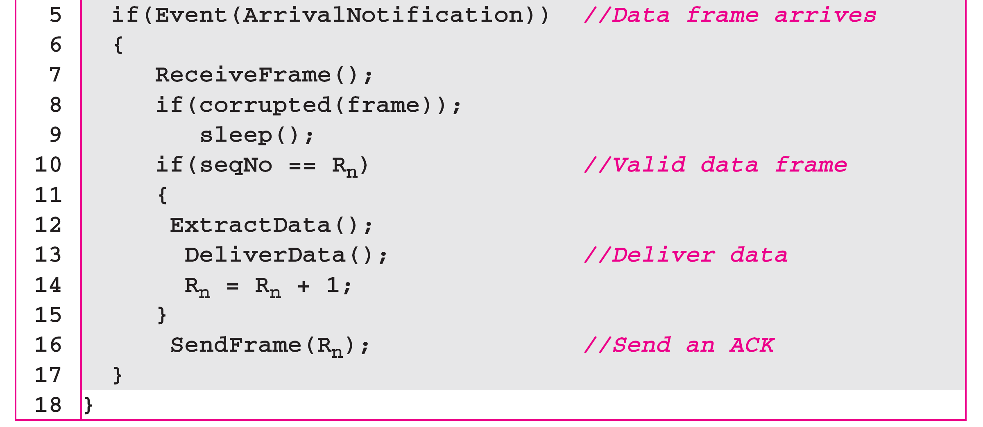
Receiver-site algorithm for Stop-and-Wait ARQ Protocol

Slide 42
Example 1
shows an example of Stop-and-Wait ARQ. Frame 0 is sent and acknowledged. Frame 1 is lost and resent after the time-out. The resent frame 1 is acknowledged and the timer stops. Frame 0 is sent and acknowledged, but the acknowledgment is lost. The sender has no idea if the frame or the acknowledgment is lost, so after the time-out, it resends frame 0, which is acknowledged.

Slide 43
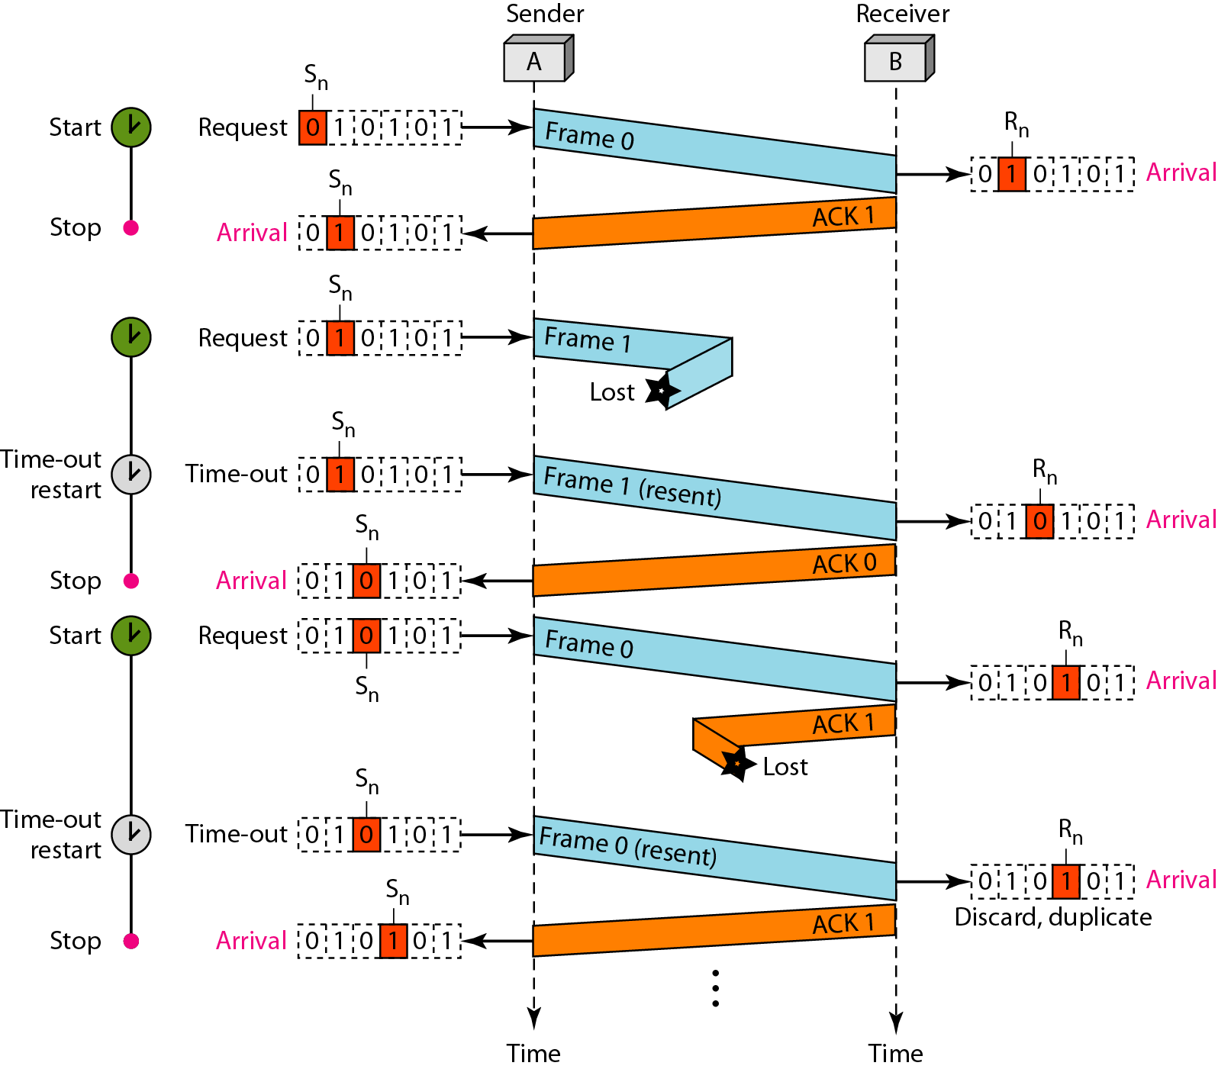
Flow diagram

Slide 44
Go-Back-N Automatic Repeat Request
In the Go-Back-N Protocol, the sequence numbers are modulo 2^{m}, where m is the size of the sequence number field in bits.
The send window is an abstract concept defining an imaginary box of size 2^{m} − 1 with three variables: Sf, Sn, and S_{size}.
The send window can slide one or more slots when a valid acknowledgment arrives.

Slide 45
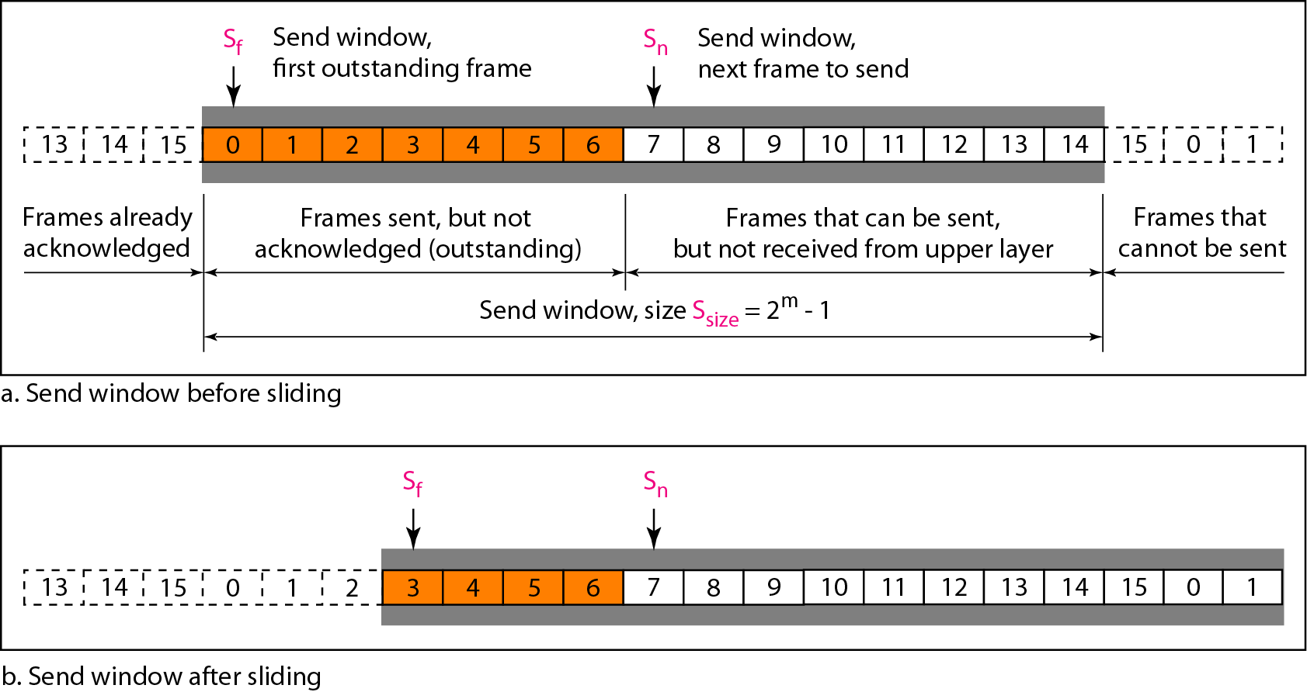
Send window for Go-Back-N ARQ

Slide 46
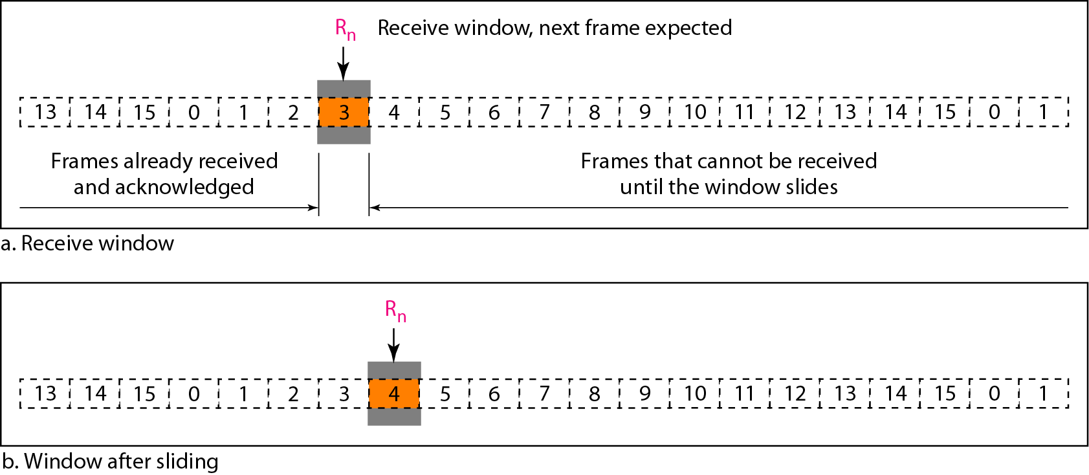
Receive window for Go-Back-N ARQ

Slide 47
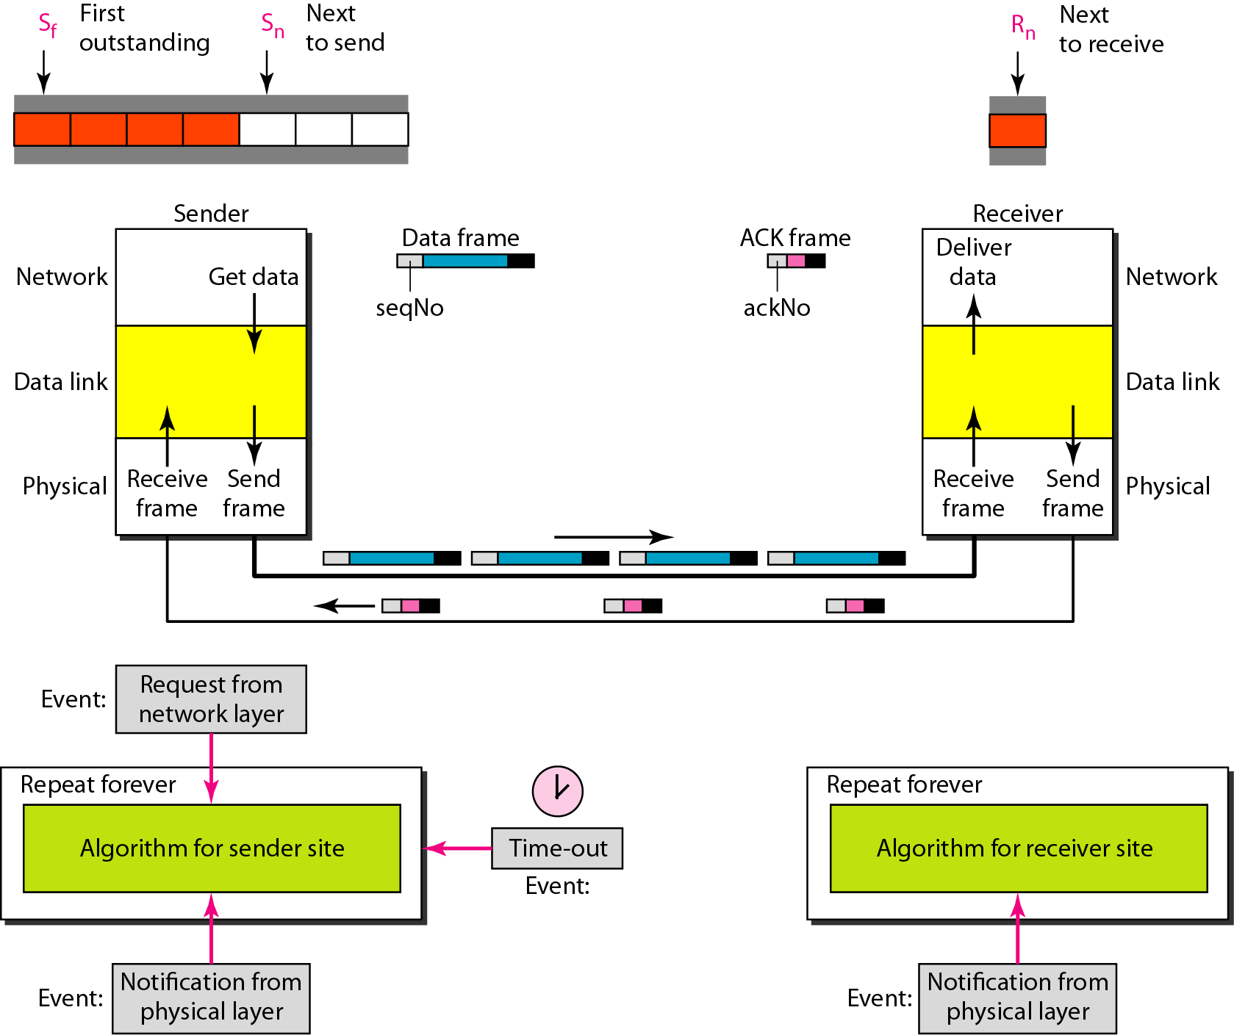
Design of Go-Back-N ARQ

Slide 48
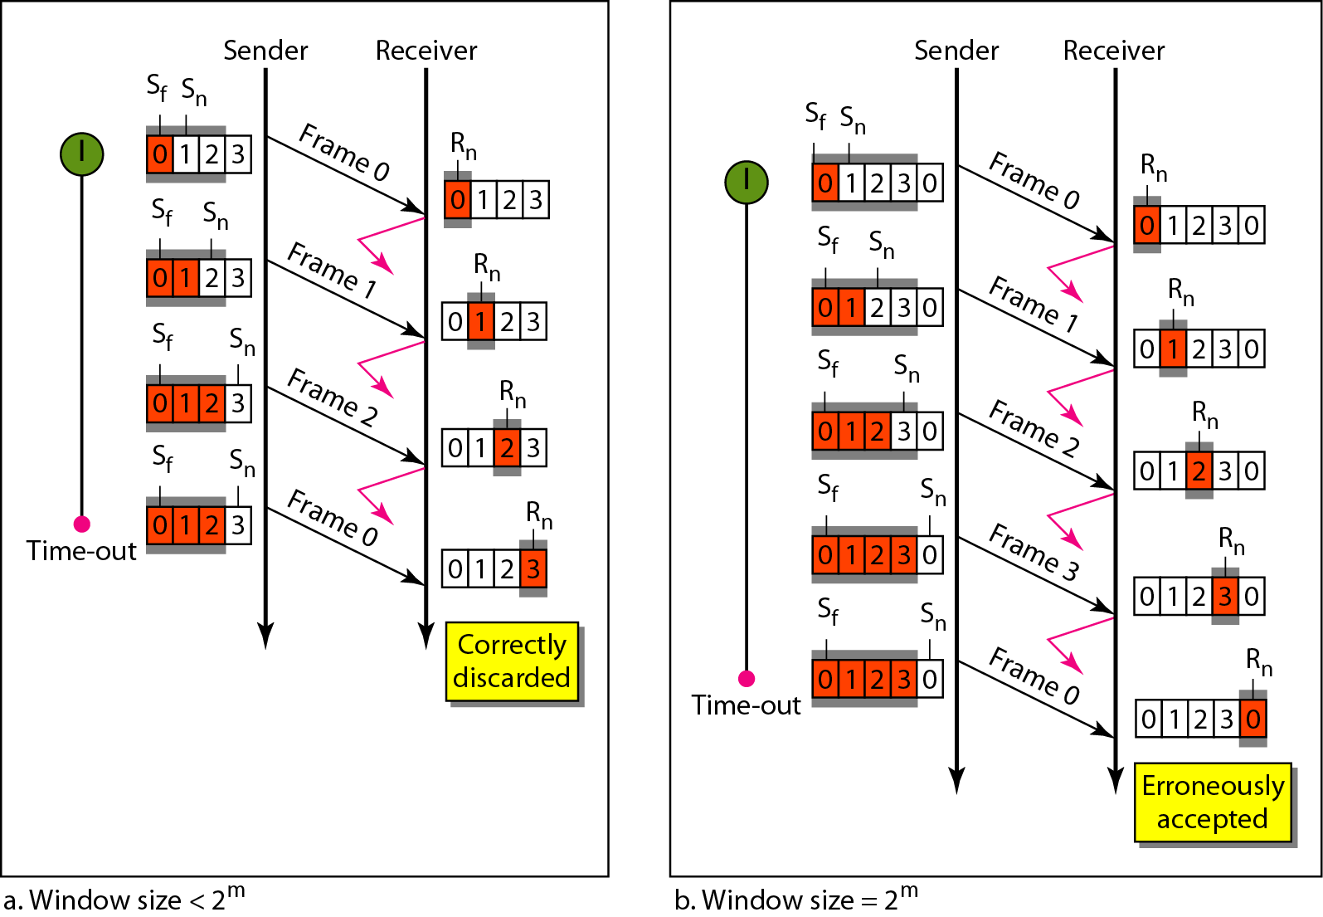
Window size for Go-Back-N ARQ
In Go-Back-N ARQ, the size of the send window must be less than 2m;
the size of the receiver window is always 1.

Slide 49
Algorithm Go-Back-N sender algorithm

Slide 50
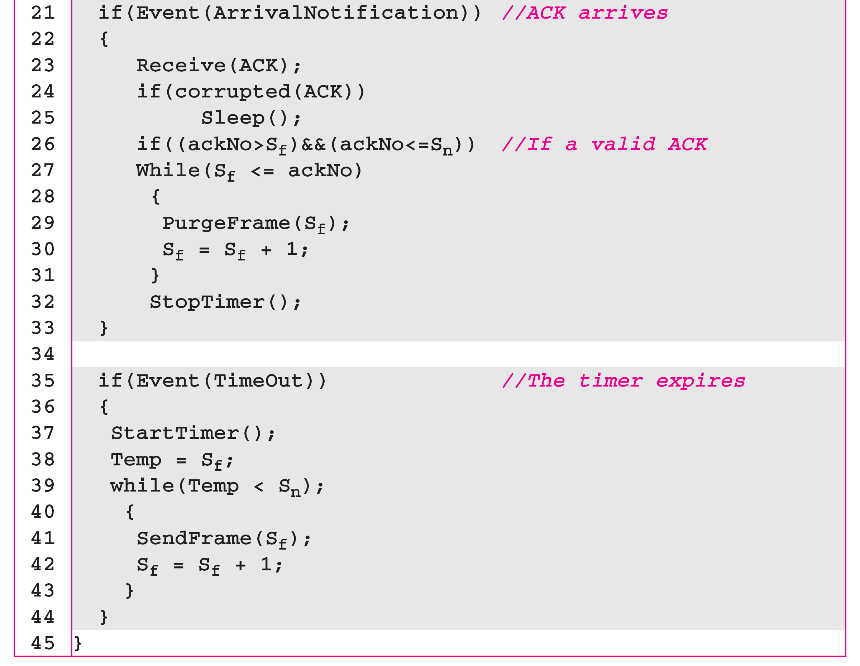
Algorithm Go-Back-N sender algorithm

Slide 51
Algorithm Go-Back-N receiver algorithm

Slide 52
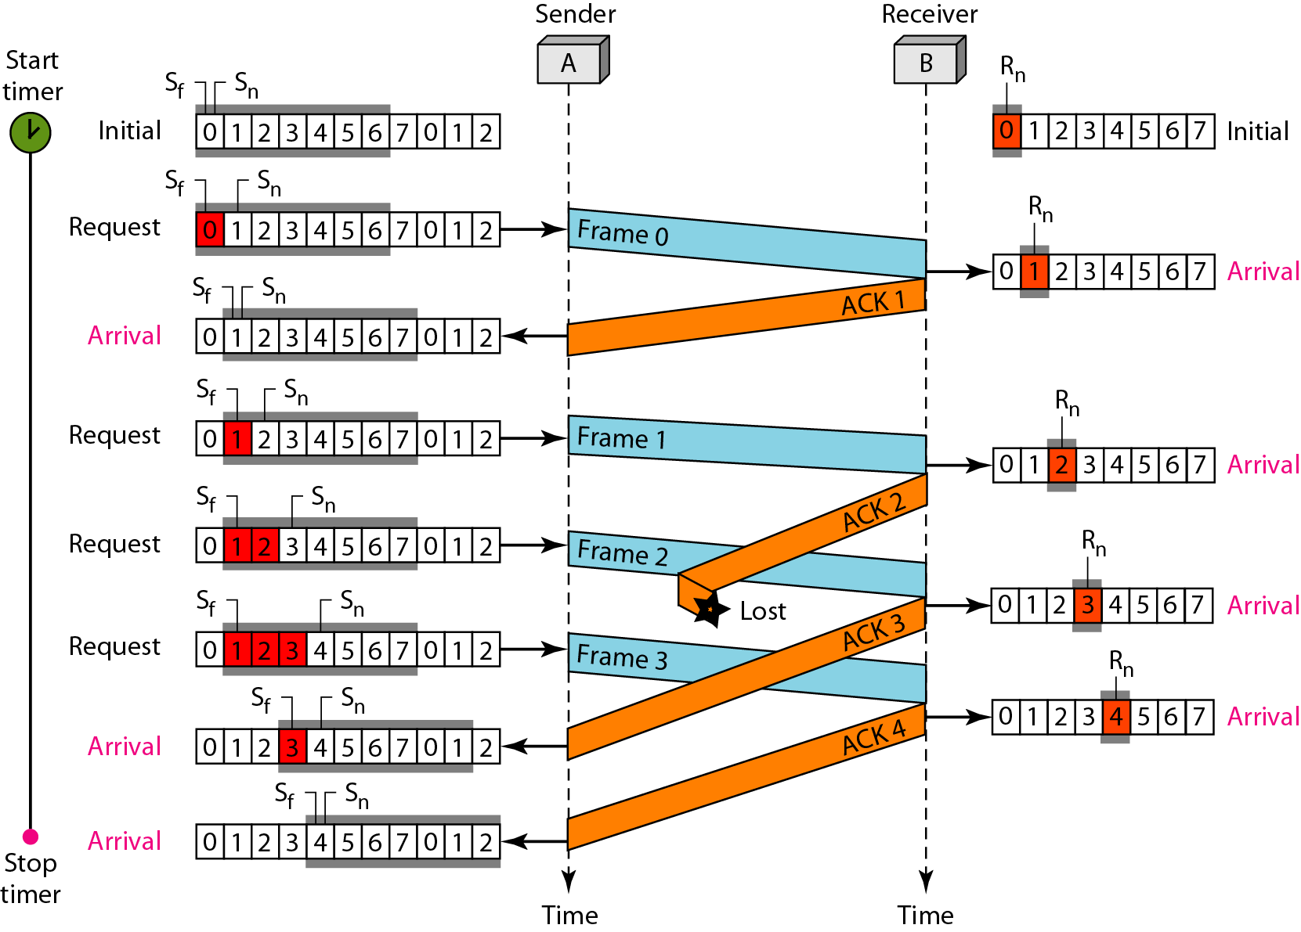
Flow diagram

Slide 53
Comparison of Go-Back-N and Selective Repeat
Go-Back-N Protocol and “Selective Repeat Protocol” are the sliding window protocols. The sliding window protocol is primarily an error control protocol
The basic difference between go-back-n protocol and selective repeat protocol is that the “go-back-n protocol” retransmits all the frames that lie after the frame which is damaged or lost. The “selective repeat protocol” retransmits only that frame which is damaged or lost.

Slide 54
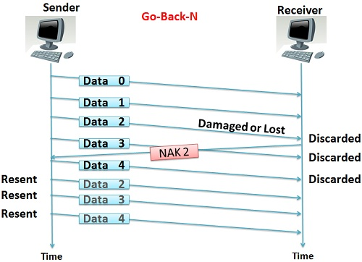
Go-Back-N

Slide 55
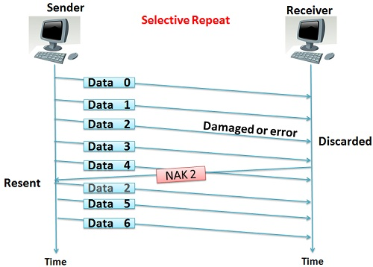
Selective Repeat

Slide 56
BASIS FOR COMPARISON | GO-BACK-N | SELECTIVE REPEAT
Basic | Retransmits all the frames that sent after the frame which suspects to be damaged or lost. | Retransmits only those frames that are suspected to lost or damaged.
Bandwidth Utilization | If error rate is high, it wastes a lot of bandwidth. | Comparatively less bandwidth is wasted in retransmitting.
Complexity | Less complicated. | More complex as it require to apply extra logic and sorting and storage, at sender and receiver.
Window size | N-1 | <= (N+1)/2
Sorting | Sorting is neither required at sender side nor at receiver side. | Receiver must be able to sort as it has to maintain the sequence of the frames.
Storing | Receiver do not store the frames received after the damaged frame until the damaged frame is retransmitted. | Receiver stores the frames received after the damaged frame in the buffer until the damaged frame is replaced.
ACK Numbers | NAK number refer to the next expected frame number. | NAK number refer to the frame lost.
Use | It more often used. | It is less in practice because of its complexity.

Slide 57
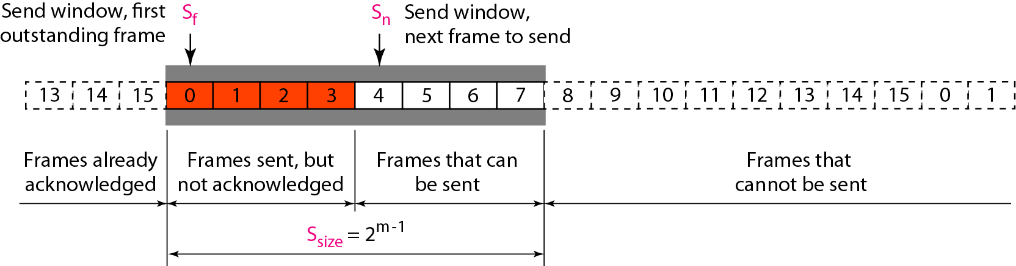
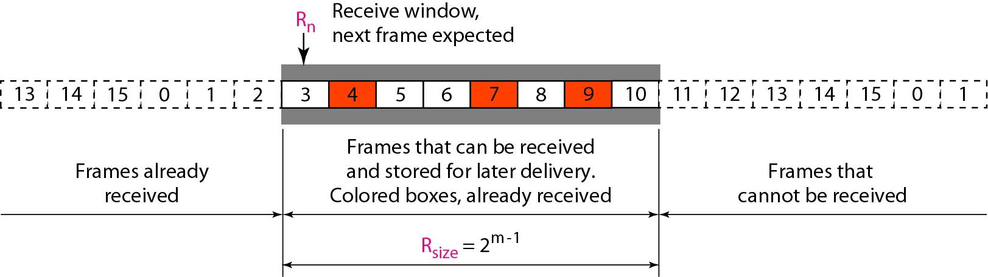
Send window for Selective Repeat ARQ
Receive window for Selective Repeat ARQ

Slide 58
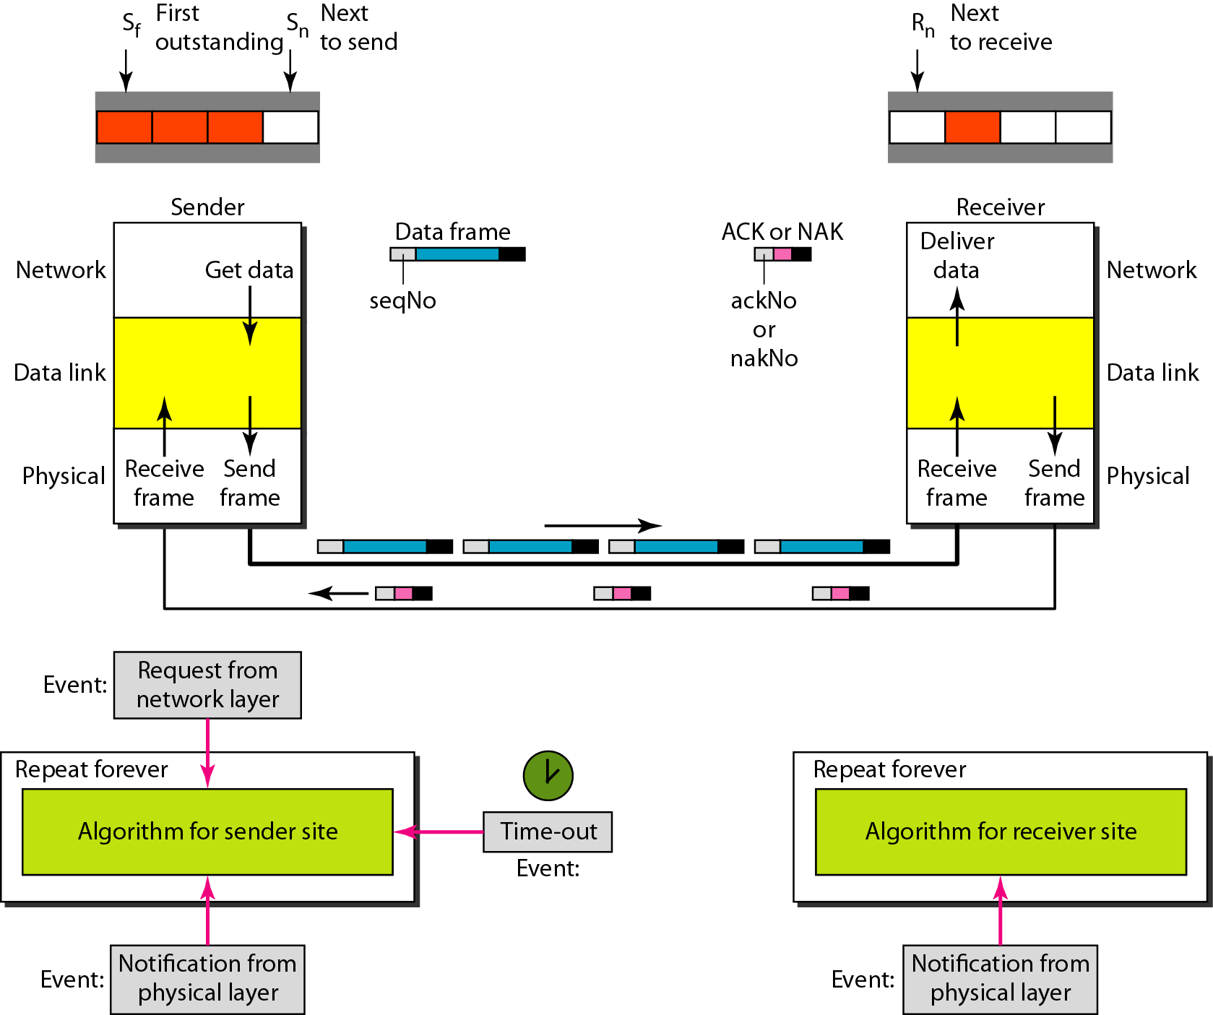
Design of Selective Repeat ARQ

Slide 59
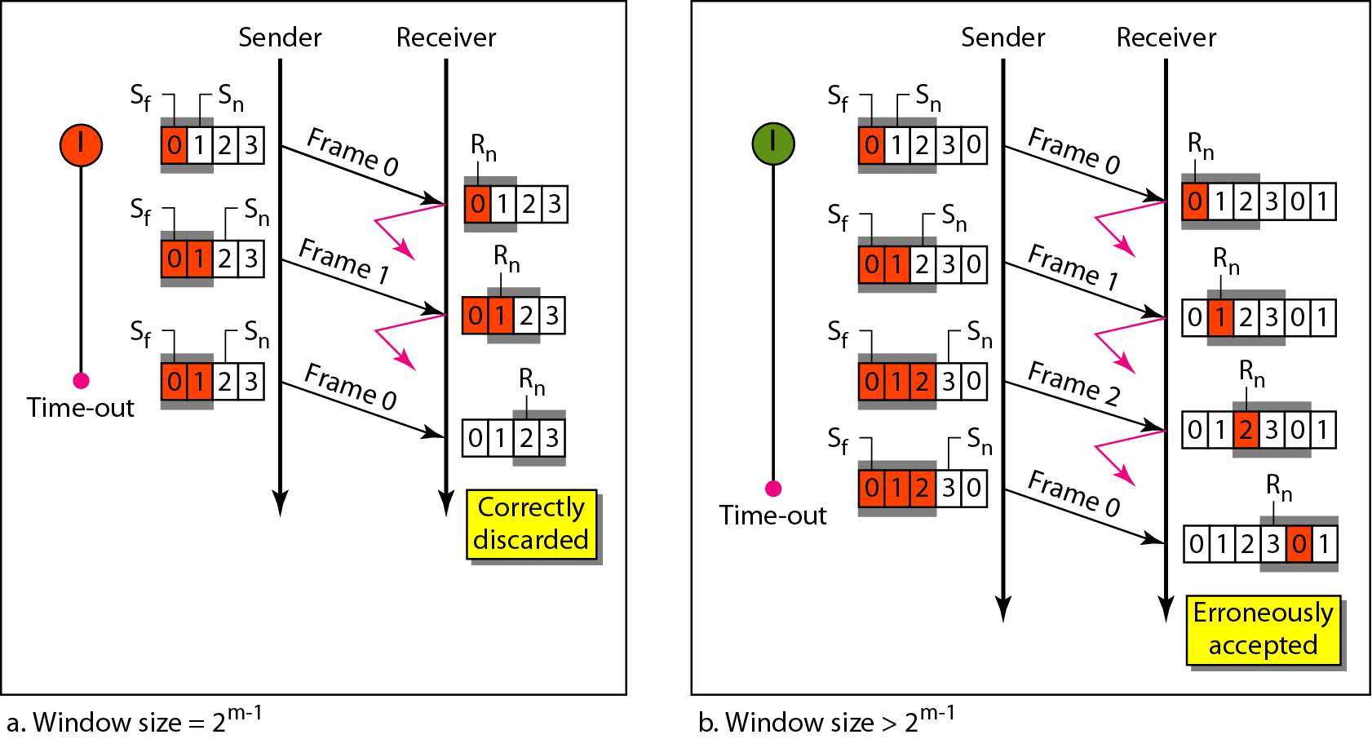
Selective Repeat ARQ, window size
In Selective Repeat ARQ, the size of the sender and receiver window
must be at most one-half of 2m.

Slide 60
Algorithm Sender-site Selective Repeat algorithm

Slide 61
Algorithm Sender-site Selective Repeat algorithm

Slide 62
Algorithm Sender-site Selective Repeat algorithm

Slide 63
Algorithm Receiver-site Selective Repeat algorithm

Slide 64
Algorithm Receiver-site Selective Repeat algorithm

Slide 65
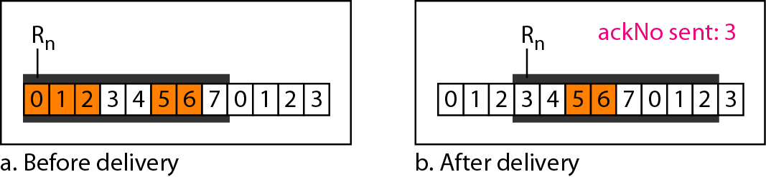
Figure Delivery of data in Selective Repeat ARQ

Slide 66
BLOCK CODING
In block coding, we divide our message into blocks, each of k bits, called datawords. We add r redundant bits to each block to make the length n = k + r. The resulting n-bit blocks are called codewords.
To detect or correct errors, we need to send extra (redundant) bits with data.
Topics discussed in this section:
Error Detection Error Correction Hamming Distance

Slide 67
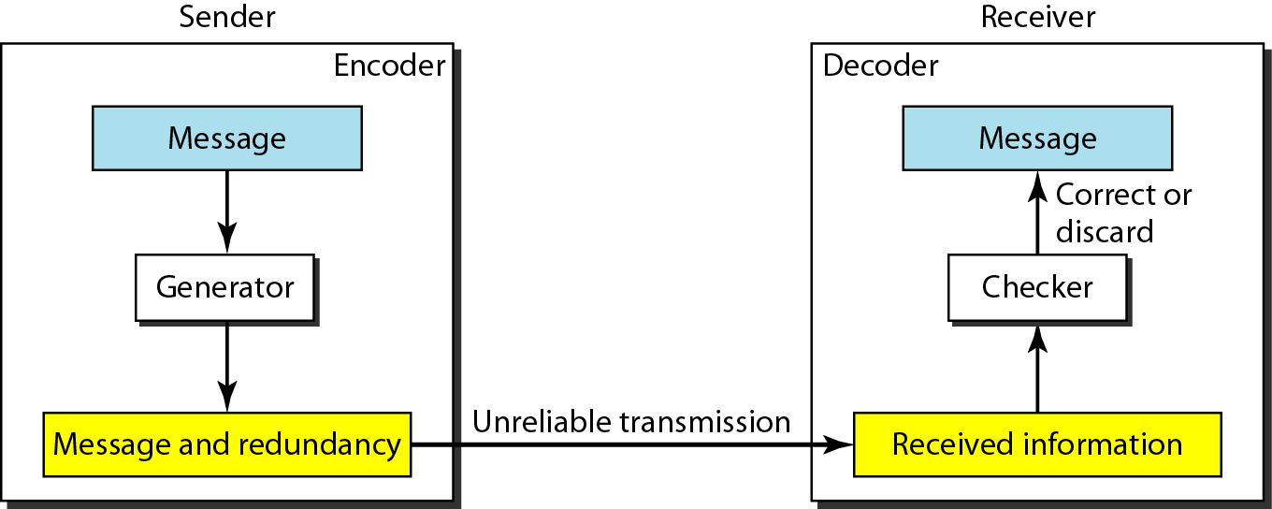
Figure The structure of encoder and decoder

Slide 68
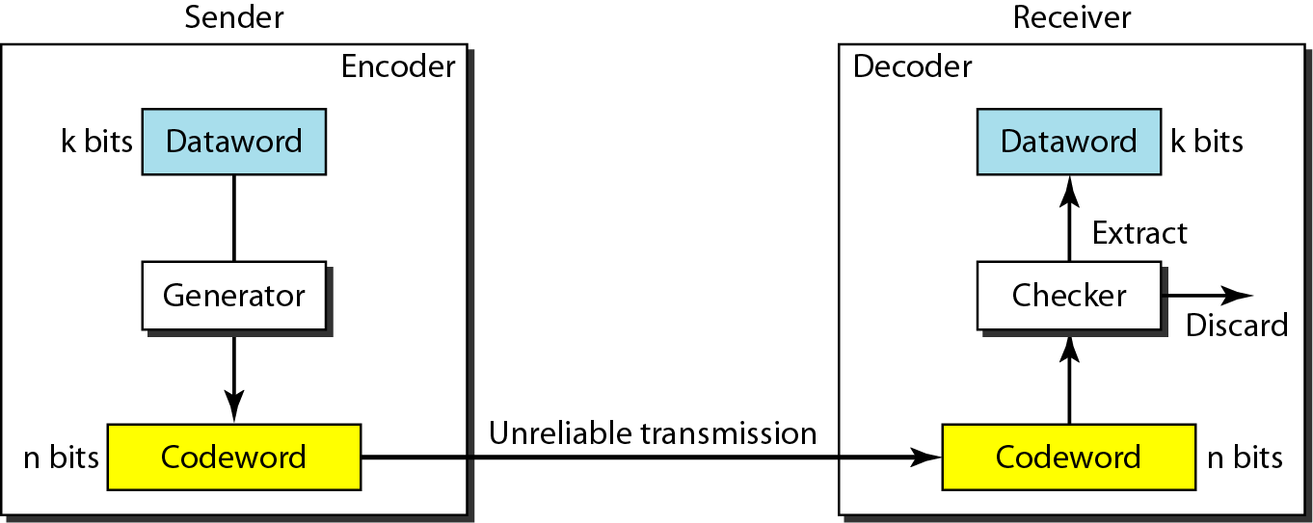
Error Detection
The receiver has a list of valid codewords.
The original codeword has changed to an invalid one.
The codeword is corrupted during transmission but the received word still matches a valid codeword, the remains undetected.
This type of coding can detect only single errors
Figure Process of error detection in block coding

Slide 69
Example
Let us assume that k = 2 and n = 3. Table 10.1 shows the list of datawords and codewords (even parity). It is only good for detecting one bit error.
A code for error detection
00 | 000
01 | 011
10 | 101
11 | 110
An error-detecting code can detect only the types of errors for which it is designed; other types of errors may remain undetected.

Slide 70
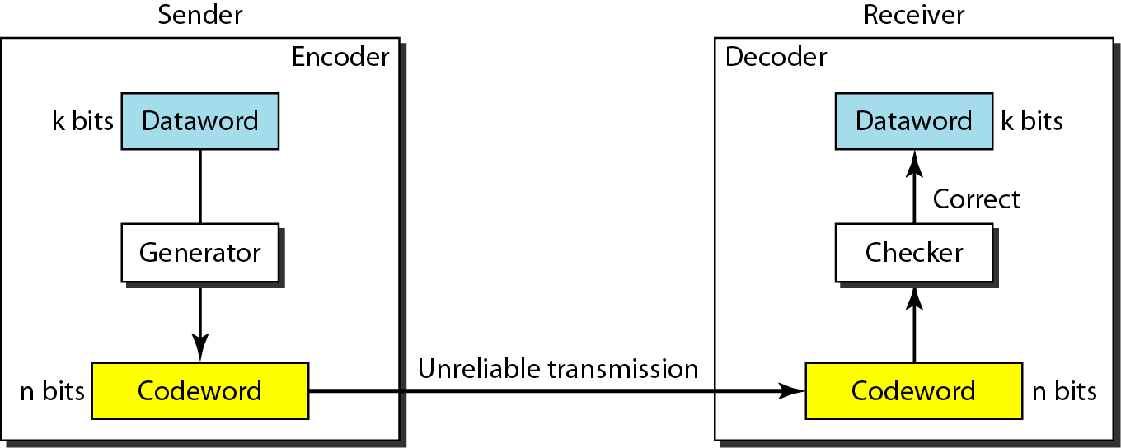
Error Correction
It is much more difficult than error detection.
In error detection, the receiver needs to know only the received codeword is invalid; in error correction the receiver needs to find the original codeword sent.
It needs more redundant bits than error detection.
Structure of encoder and decoder in error correction

Slide 71
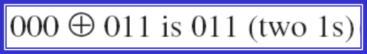
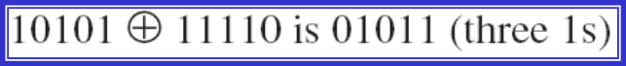
Hamming Code
The Hamming distance between two words is the number of differences between corresponding bits.
It can easily be found if we apply the XOR operation on the two words and count the number of 1s in the result.
Let us find the Hamming distance between two pairs of words.
1. The Hamming distance d(000, 011) is 2 because
2. The Hamming distance d(10101, 11110) is 3 because

Slide 72
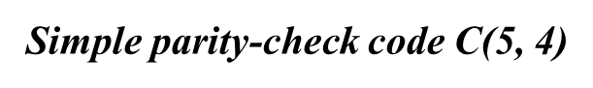
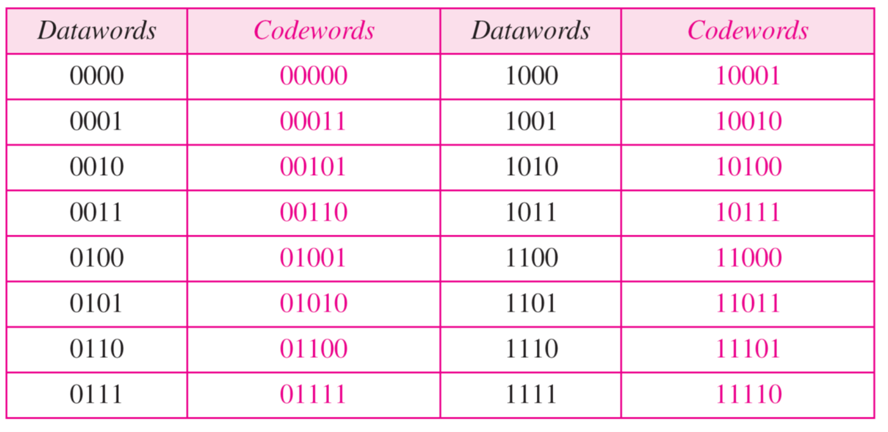
Parity Check
A simple parity-check code is a single-bit error-detecting code in which n = k + 1 with d_{min} = 2.
K-bit dataword is changed to an n-bit codeword where n=k+1. the extra bit called the parity bit.

Slide 73
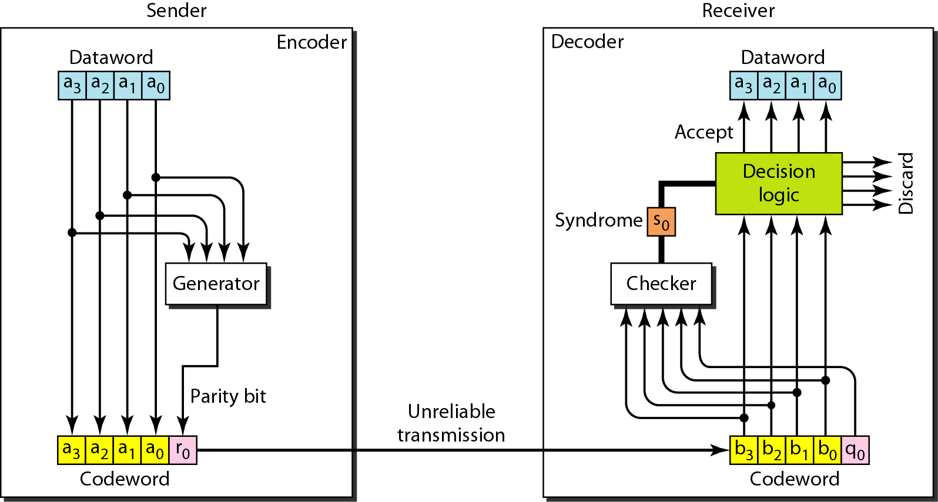
Encoder and decoder for simple parity-check code
The result, which is called the syndrome, is just 1 bit.
The syndrome is 0 when the number of 1s in the received codeword is even; otherwise, it is 1.

Slide 74
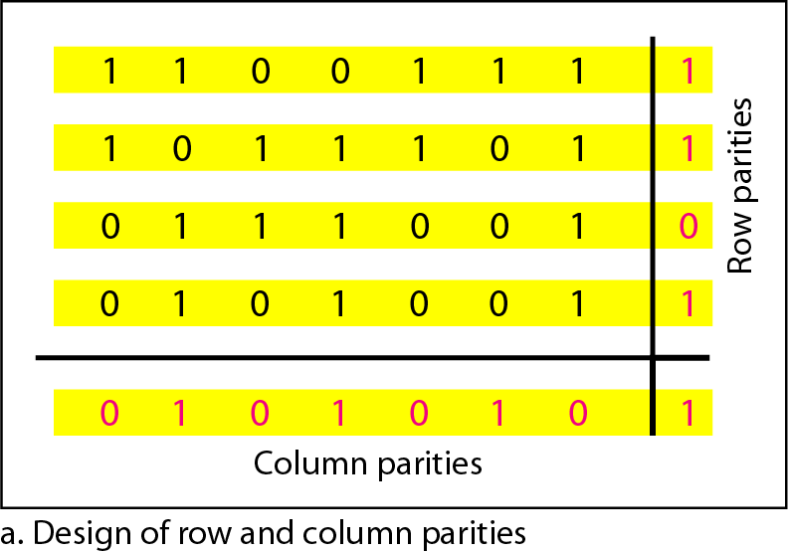
Hamming Distance
The code were originally designed with d_{min=3}, which means that they can detect up to 2 errors or correct 1 single error.
We need to choose an integer m>=3. The values of n and k are then calculated from m as n=2^{m} -1 and k=n-m. The number of check bits r = m.
If m=3, then n=7 and k=4. Hamming code C(7,4) with d_{min} =3.
Two-dimensional parity-check code

Slide 75
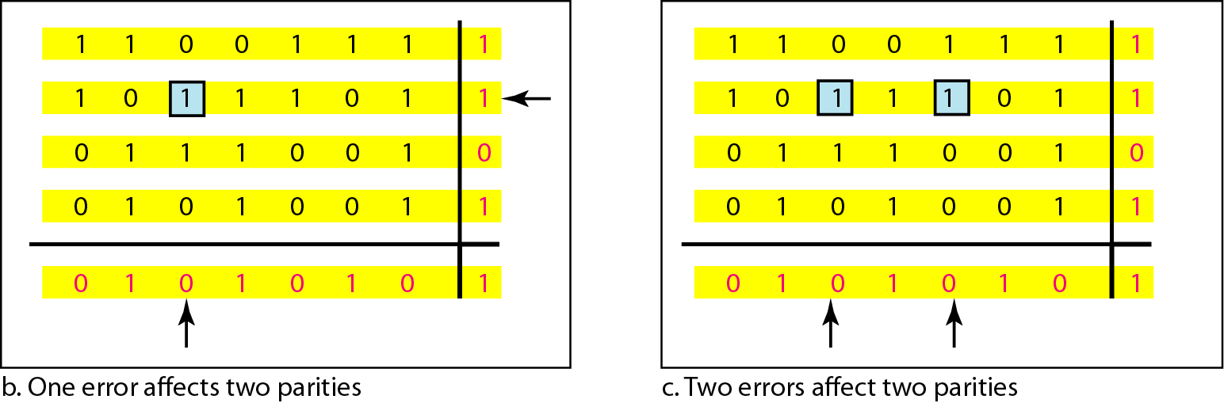
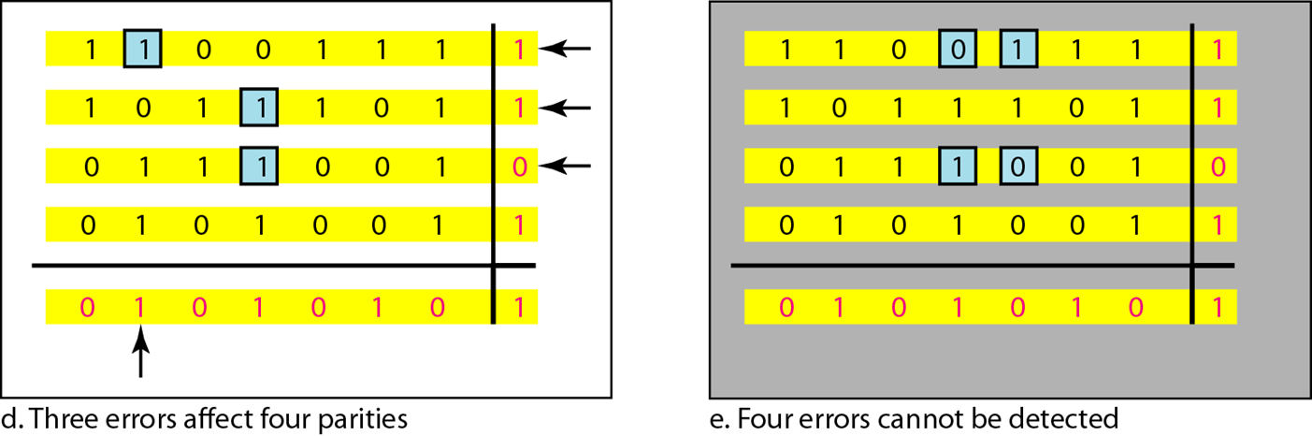
Two-dimensional parity-check code

Slide 76

The structure of the encoder and decoder for a Hamming code

Slide 77

Hamming code C(7, 4) - n=7, k = 4
Parity checks are created as follow (using modulo-2)
r0 = a2 + a1 + a0
r1 = a3 + a2 + a1
r2 = a1 + a0 + a3

Slide 78


The checker in the decoder creates a 3-bit syndrome (s2 s1 s0).
In which each bit is the parity check for 4 out of the 7 bits in the received codeword:
s0 = b2 + b1 + b0 + q0
s1 = b3 + b2 + b1 + q1
s2 = b1 + b0 + b3 + q2
The equations used by the checker are the same as those used by the generator with the parity-check bits added to the right-hand side of the equation.

Slide 79

Burst error correction using Hamming code
Split burst error between multiple codewords

Slide 80
CHECKSUM
The last error detection method we discuss here is called the checksum. The checksum is used in the Internet by several protocols although not at the data link layer. However, we briefly discuss it here to complete our discussion on error checking
Topics discussed in this section:
Idea One’s Complement Internet Checksum

Slide 81

Idea
Example
Suppose our data is a list of five 4-bit numbers that we want to send to a destination. In addition to sending these numbers, we send the sum of the numbers. For example, if the set of numbers is (7, 11, 12, 0, 6), we send (7, 11, 12, 0, 6, 36), where 36 is the sum of the original numbers. The receiver adds the five numbers and compares the result with the sum. If the two are the same, the receiver assumes no error, accepts the five numbers, and discards the sum. Otherwise, there is an error somewhere and the data are not accepted.
We can make the job of the receiver easier if we send the negative (complement) of the sum, called the checksum. In this case, we send (7, 11, 12, 0, 6, −36). The receiver can add all the numbers received (including the checksum). If the result is 0, it assumes no error; otherwise, there is an error.

Slide 82
One’s Complement
We can represent unsigned numbers between 0 and 2^{n} -1 using only n bits.
If the number has more than n bits, the extra leftmost bits need to be added to the n rightmost bits(Wrapping).
A negative number can be represented by inverting all bits.
Example
How can we represent the number 21 in one’s complement arithmetic using only four bits?
Solution
The number 21 in binary is 10101 (it needs five bits). We can wrap the leftmost bit and add it to the four rightmost bits. We have (0101 + 1) = 0110 or 6.

Slide 83
Example
How can we represent the number −6 in one’s complement arithmetic using only four bits?
Solution
In one’s complement arithmetic, the negative or complement of a number is found by inverting all bits. Positive 6 is 0110; negative 6 is 1001. If we consider only unsigned numbers, this is 9. In other words, the complement of 6 is 9.

Slide 84

1
1
1
0

Slide 85
Internet Checksum
Sender site:
1. The message is divided into 16-bit words.
2. The value of the checksum word is set to 0.
3. All words including the checksum are added using one’s complement addition.
4. The sum is complemented and becomes the checksum.
5. The checksum is sent with the data.
Receiver site:
1. The message (including checksum) is divided into 16-bit words.
2. All words are added using one’s complement addition.
3. The sum is complemented and becomes the new checksum.
4. If the value of checksum is 0, the message is accepted; otherwise, it is rejected.

Slide 86
Internet Checksum Example
When adding numbers, a carryout from the most significant bit needs to be added to the result
Example: add two 16-bit integers
1 1 1 1 0 0 1 1 0 0 1 1 0 0 1 1 0
1 1 1 0 1 0 1 0 1 0 1 0 1 0 1 0 1
1 1 0 1 1 1 0 1 1 1 0 1 1 1 0 1 1
1 1 0 1 1 1 0 1 1 1 0 1 1 1 1 0 0
1 0 1 0 0 0 1 0 0 0 1 0 0 0 0 1 1
wraparound
sum
checksum
Notes:
Kurose and Ross forgot to say anything about wrapping the carry and adding it to low order bit

Slide 87
Ethernet
IEEE has standardized a number of LANs and MANs under the name of IEEE 802. A few have survived but many have not.
The most important of the survivors are 802.3 (Ethernet) and 802.11 (wireless LAN)
For 802.15 (Bluetooth) and 802.16 (wireless MAN), it is too early to tell.
Both 802.3 and 802.11 have different physical layers and different MAC sublayers but converge on the same logical link control sublayer (defined in 802.2), so they have the same interface to the network layer.

Slide 88
Ethernet Cabling
Name | Cable | Max seg. (m) | Nodes per segment | Advantages
10Base5 | thick coax | 500 | 100 | The Original
10Base2 | thin coax | 185 | 30 | no hub
10Base-T | twisted pair (UTP) | 100 | 1024 | cheapest
10Base-F | fiber | 2000 | 1024 | long distance

Slide 89

Three kinds of Ethernet cabling
10Base5 10Base2 10Base-T

Slide 90

Cable topologies
Linear Spine (bus) Tree Segmented

Slide 91

Manchester encoding

Slide 92

Ethernet frame formats
DIX (DEC, Intel, Xerox)
IEEE 802.3

Slide 93
Ethernet frame format
Preamble: Sequence of 10101010s. 8 bytes.
(SOF, Start of Frame delimiter, for compatibility with 802.4 and 802.5)
Addresses: 2 or 6 bytes.
high-order bit of the destination address:
0 for ordinary addresses
1 for group addresses.
bit 46 - global or local address.
Type: specifies which process to give the frame to.
(Any number <=1500 is treated as length or as type otherwise.)
Data: up to 1500 bytes.
Pad: (optional) The frame must be at least 64 bytes in total!
Checksum: CRC based on this polynomial:
x³²+x²⁶+x²³+x²²+x¹⁶+x¹²+x¹¹+x¹⁰+x⁸+x⁷+x⁵+x⁴+x²+x+1

Slide 94

Collision detection

Slide 95

Ethernet Performance
at 10 Mbps with 512-bit slot times.

Slide 96

Switched Ethernet

Slide 97
Token Ring – IEEE 802.5
A ring toplogy network developed in the late 1960s. Supported mainly by IBM. Pushed into the background by Ethernet in the 1990s.
a LAN protocol which resides at the data link layer (DLL) of the OSI model.

Slide 98

Cabling and speed
Shielded Twisted Pair with unique hermaphroditic connectors (IBM “Type 1”)
or
Symmetric pair.
Speed:
4 Mbps (1985)
16 Mpbs (1989, IBM)

Slide 99
Token Ring frame formats
Data or command frame
SD | AC | FC | DA | SA | PDU from LLC (IEEE 802.2) | CRC | ED | FS
8 bits | 8 bits | 8 bits | 48 bits | 48 bits | up to 18200x8 bits | 32 bits | 8 bits | 8 bits
Token
Abort frame
SD | AC | ED
8 bits | 8 bits | 8 bits
SD | ED
8 bits | 8 bits
SD: Starting delimiter
AC: Access control
FC: Frame control
DA: Destination address
SA: Source address
PDU: data
CRC: check sum
ED: End delimiter
FS: Frame status

Slide 100
Token Ring operation
When nobody is transmitting a token circles.
When a station needs to transmit data, it converts the token into a data frame.
When the sender receives its own data frame, it converts the frame back into a token.
If an error occurs and no token frame, or more than one, is present, a special station (“Active Monitor”) detects the problem and removes and/or reinserts tokens as necessary.
The Abort frame: used to abort transmission by the sending station.

Slide 101
Active and Standby monitors
Every station in a token ring network is either an Active monitor (AM) or Standby monitor (SM) station. There can be only one active monitor on a ring at a time. The active monitor is chosen through an election or monitor contention process.
The monitor contention process is initiated when
A loss of signal on the ring is detected,
An AM station is not detected by other stations, or
When a timer on an end station expires (the station hasn't seen a token in the past 7 seconds).
When any of the above conditions take place and a station decides that a new AM is needed.
The AM performs a number of ring management functions and roles:
Master clock for the ring, synchronization.
Inserts a 24-bit delay into the ring for sufficient buffering.
To support exactly one token and there is no frame being transmitted.
Detects a broken ring.
Removes circulating frames from the ring.

Slide 102
Token Bus – IEEE 802.4
A network which implements the modified Token Ring protocol over a "virtual ring" on a coaxial cable with a bus topology.
It is mainly used for industrial applications (GM®).
1
1
1
1
1

